Slide 1
BSC · VALUE CHAIN MANAGEMENT
The Urban Knowledge Campus
A New Source of Value Chain Advantage — adapted from HBR
Dr. Aftab Ahmad
July 2026

Slide 2
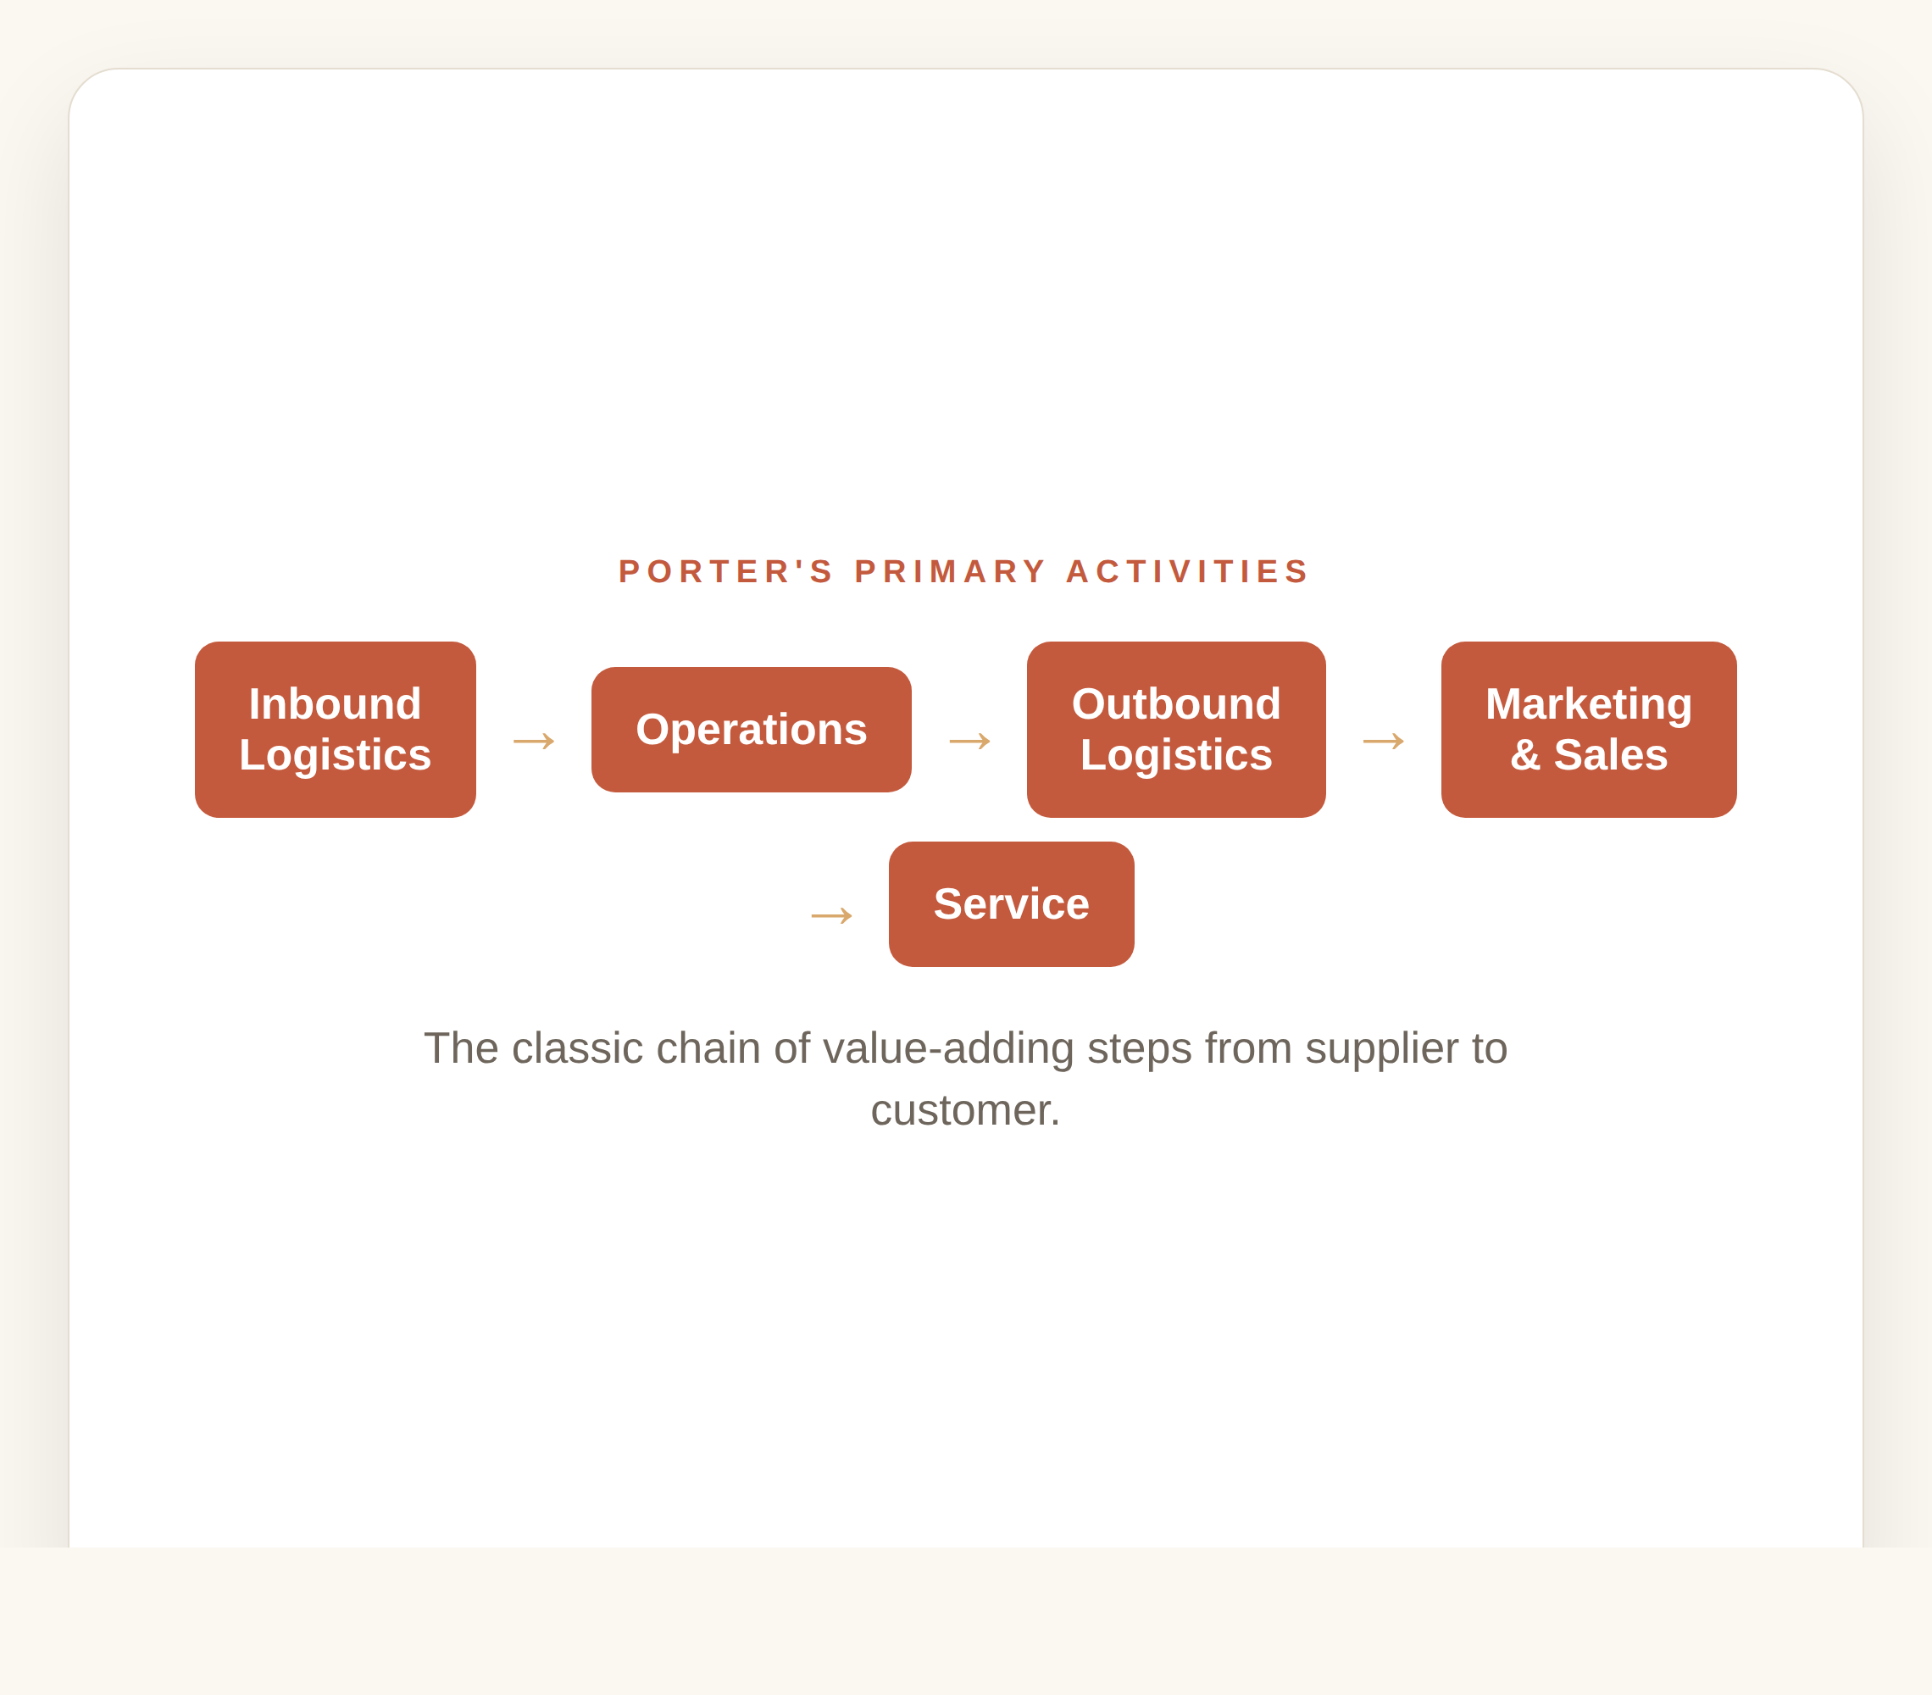
Traditional Value Chain Thinking
Porter's value chain runs Inbound Logistics → Operations → Outbound Logistics → Marketing & Sales → Service.
Each step adds value on the path from supplier to customer.
For decades, strategy focused on optimising these five primary activities.
The Urban Knowledge Campus
01

Slide 3
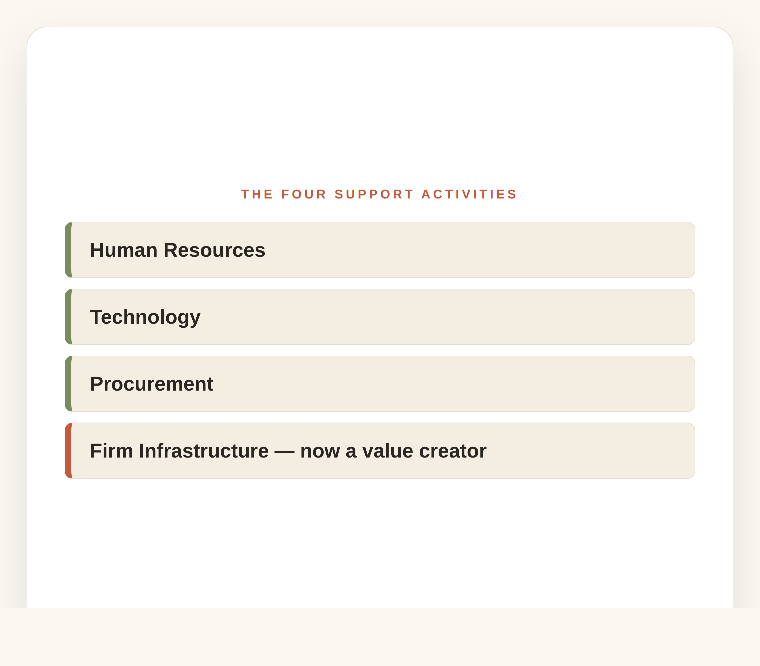
The Four Support Activities
Primary activities are supported by Human Resources, Technology, Procurement and Firm Infrastructure.
MBA insight: the HBR article expands 'infrastructure' — the workplace itself is a strategic value-creating asset.
The office is no longer an overhead cost; it is part of how value is made.
The Urban Knowledge Campus
02

Slide 4
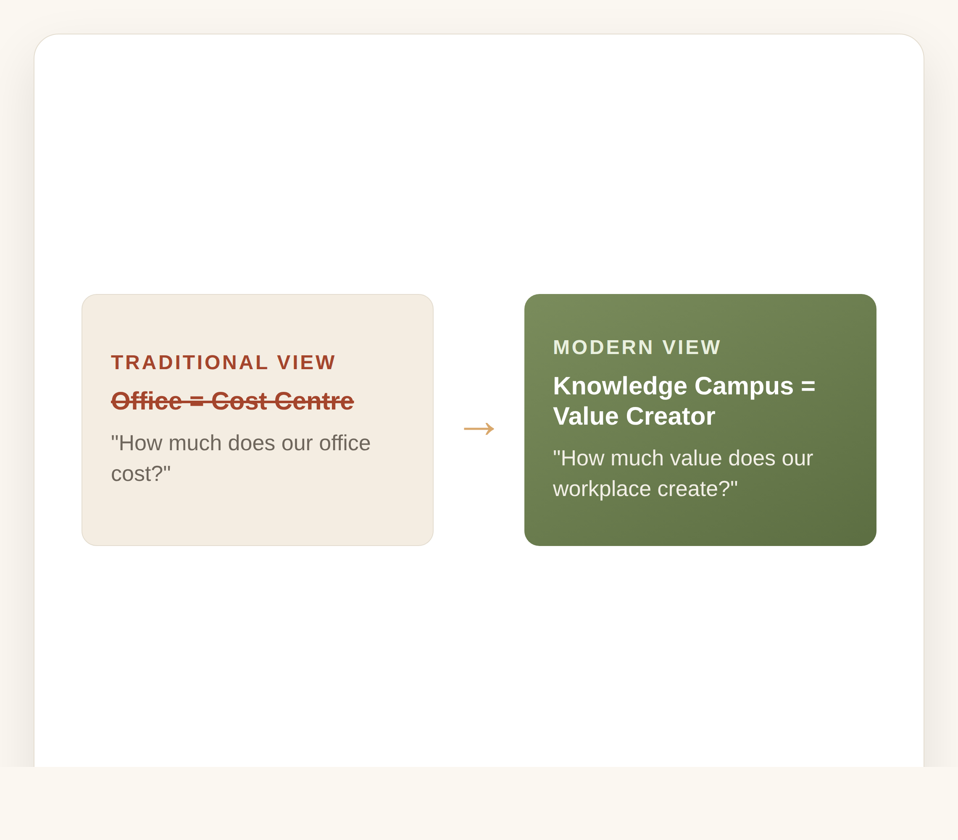
The Workplace Is Now Part of the Value Chain
Traditional view: Office = Cost Centre. Modern view: Knowledge Campus = Value Creator.
Stop asking 'How much does our office cost?' — ask 'How much value does our workplace create?'
The value shows up as faster innovation, better collaboration, wellbeing, faster decisions and better service.
The Urban Knowledge Campus
03

Slide 5
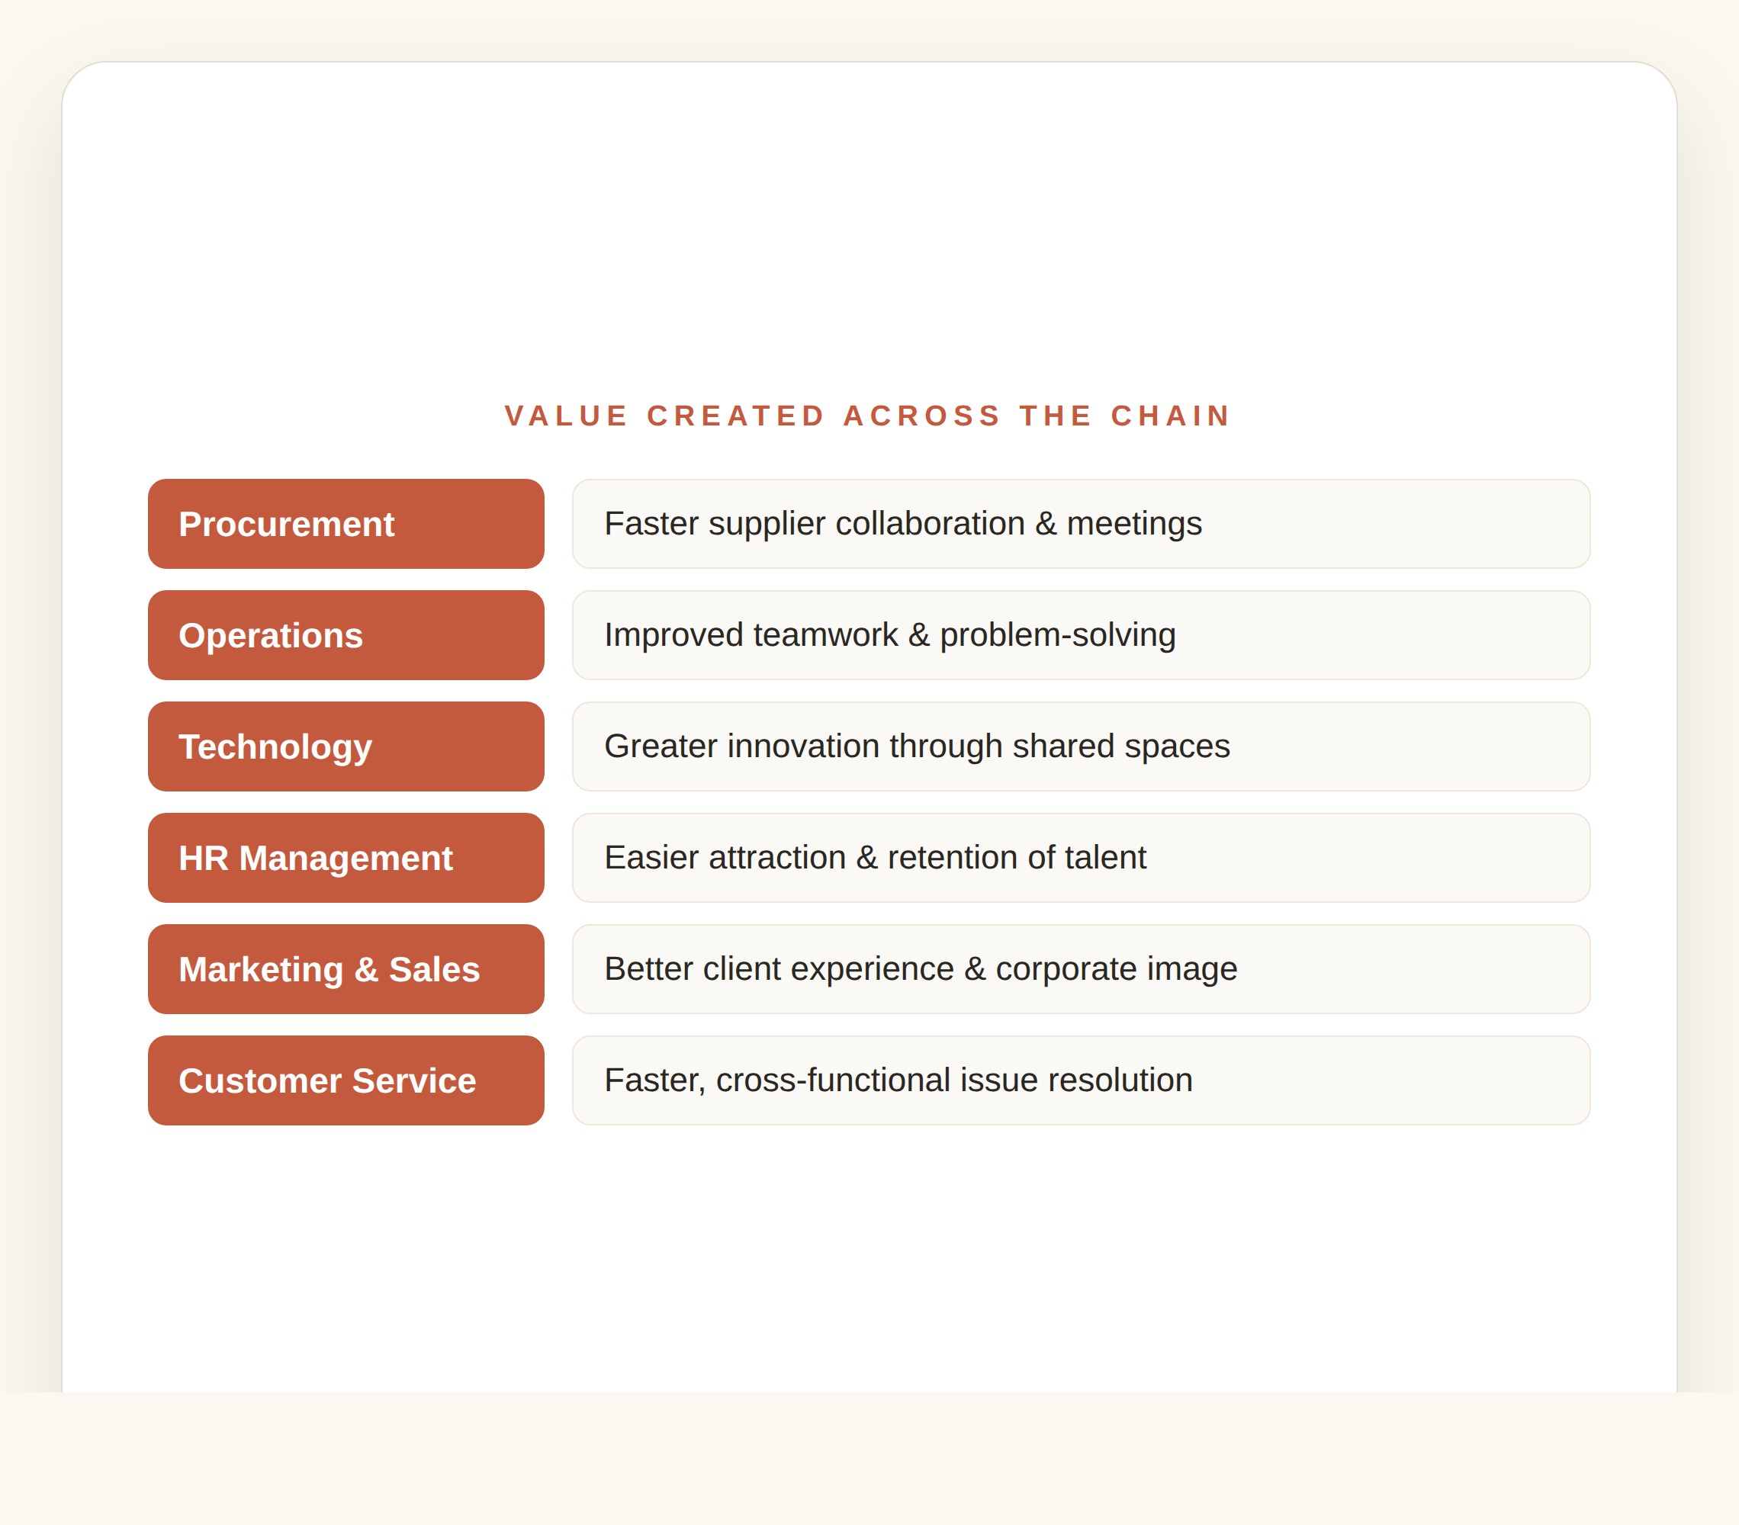
Value Created Across the Whole Chain
Procurement → faster supplier collaboration; Operations → improved teamwork and problem-solving.
Technology → more innovation in shared spaces; HR → easier attraction and retention of talent.
Marketing & Service → stronger corporate image and faster, cross-functional issue resolution.
The Urban Knowledge Campus
04

Slide 6
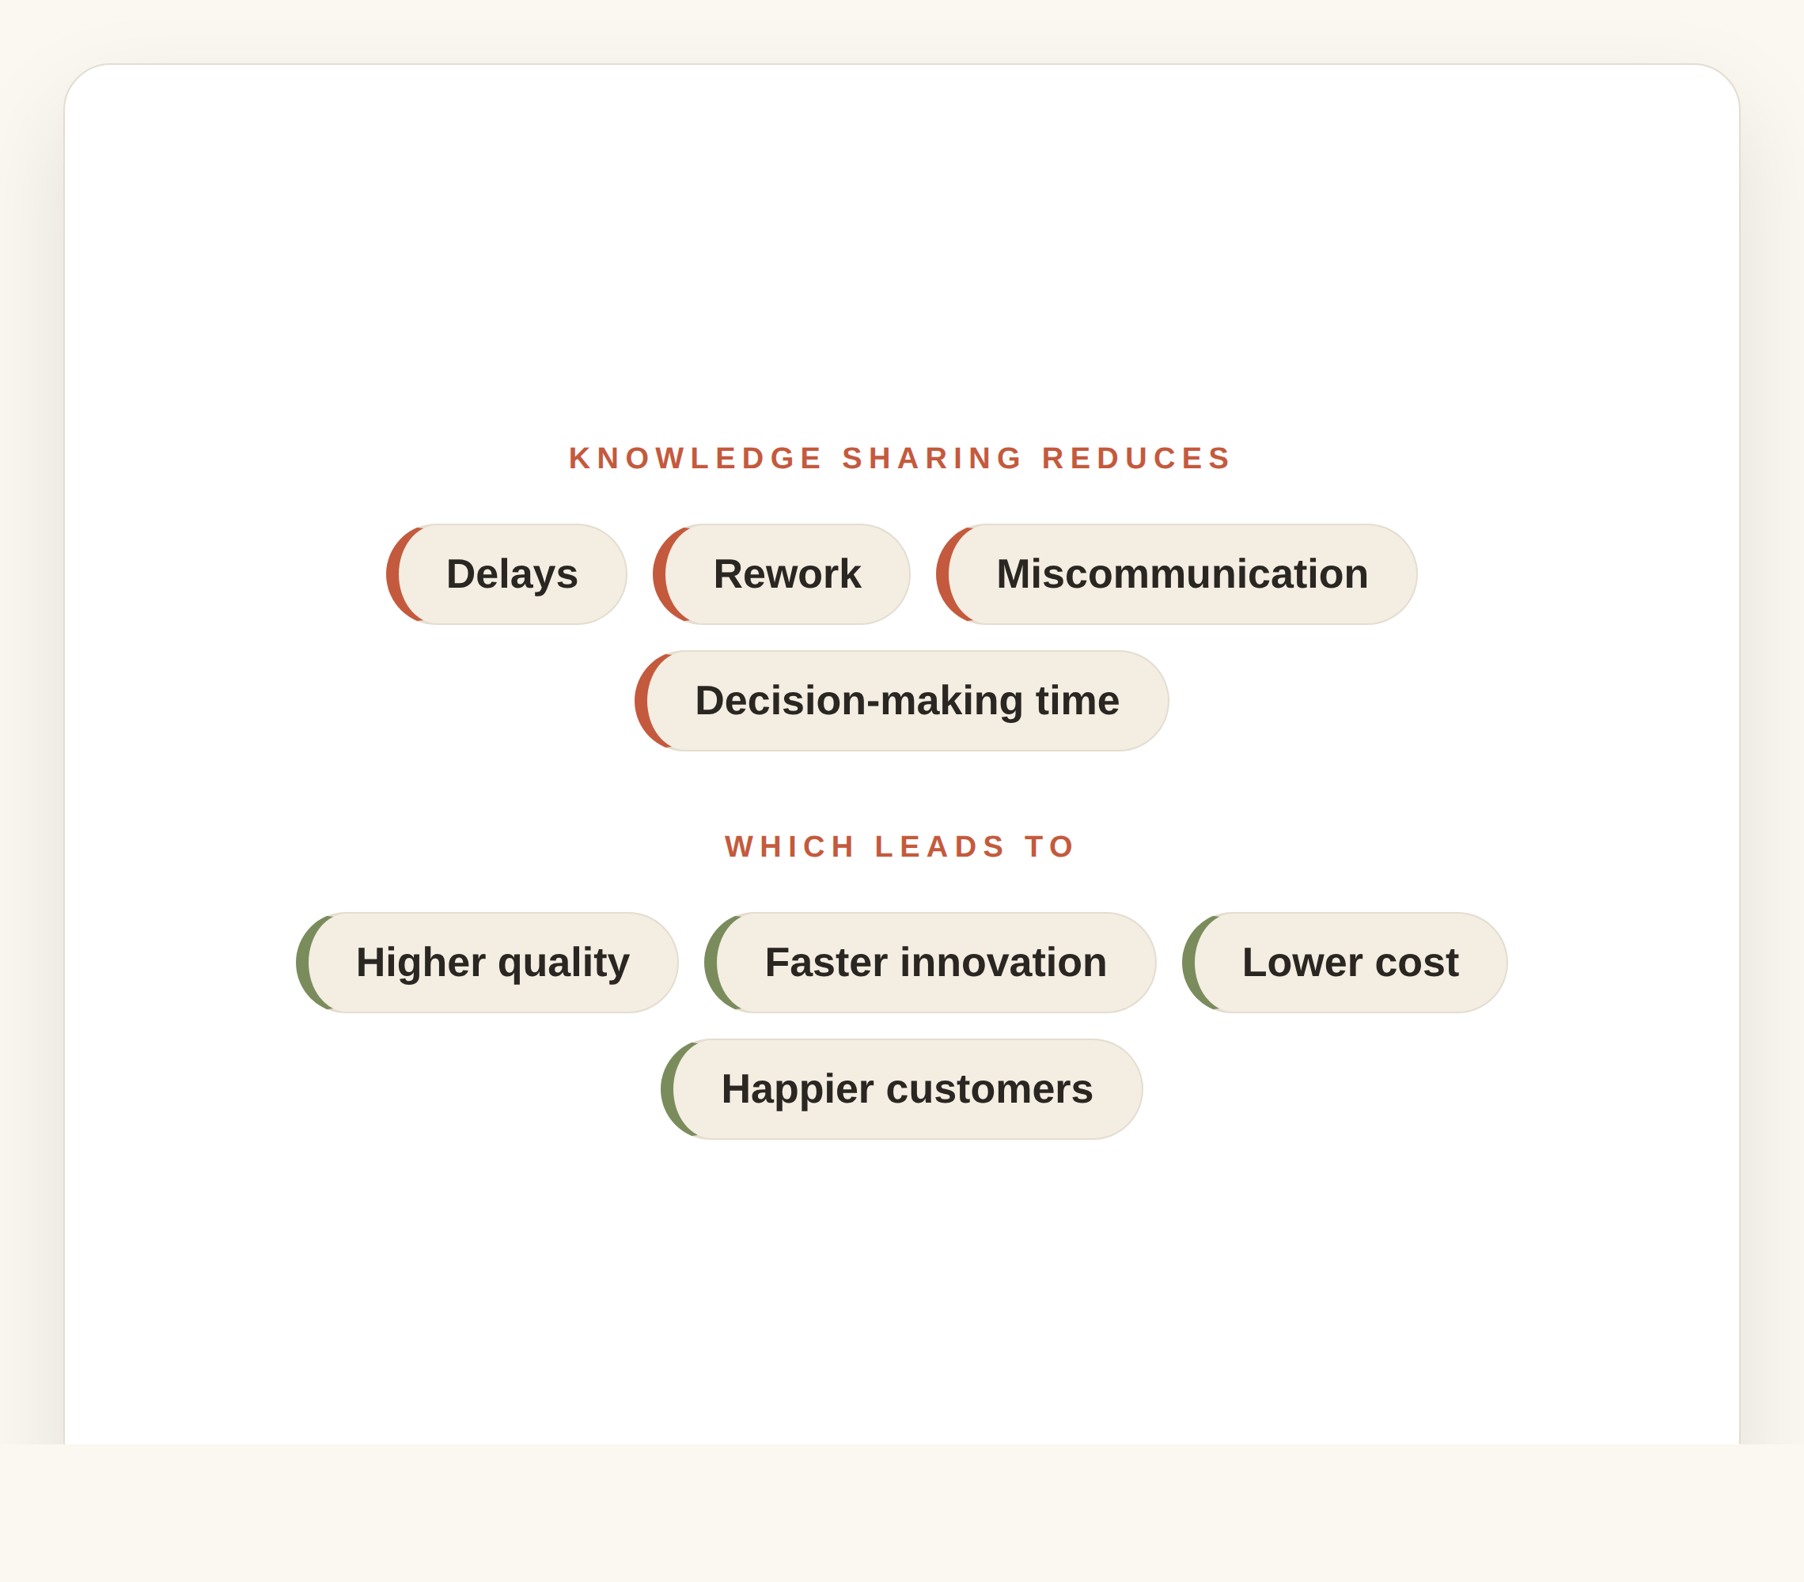
Why Collaboration Creates Value
It reduces delays, rework, miscommunication and decision-making time.
That produces higher quality, faster innovation, lower operating cost and greater customer satisfaction.
Proximity turns four sources of friction into four sources of advantage.
The Urban Knowledge Campus
05

Slide 7
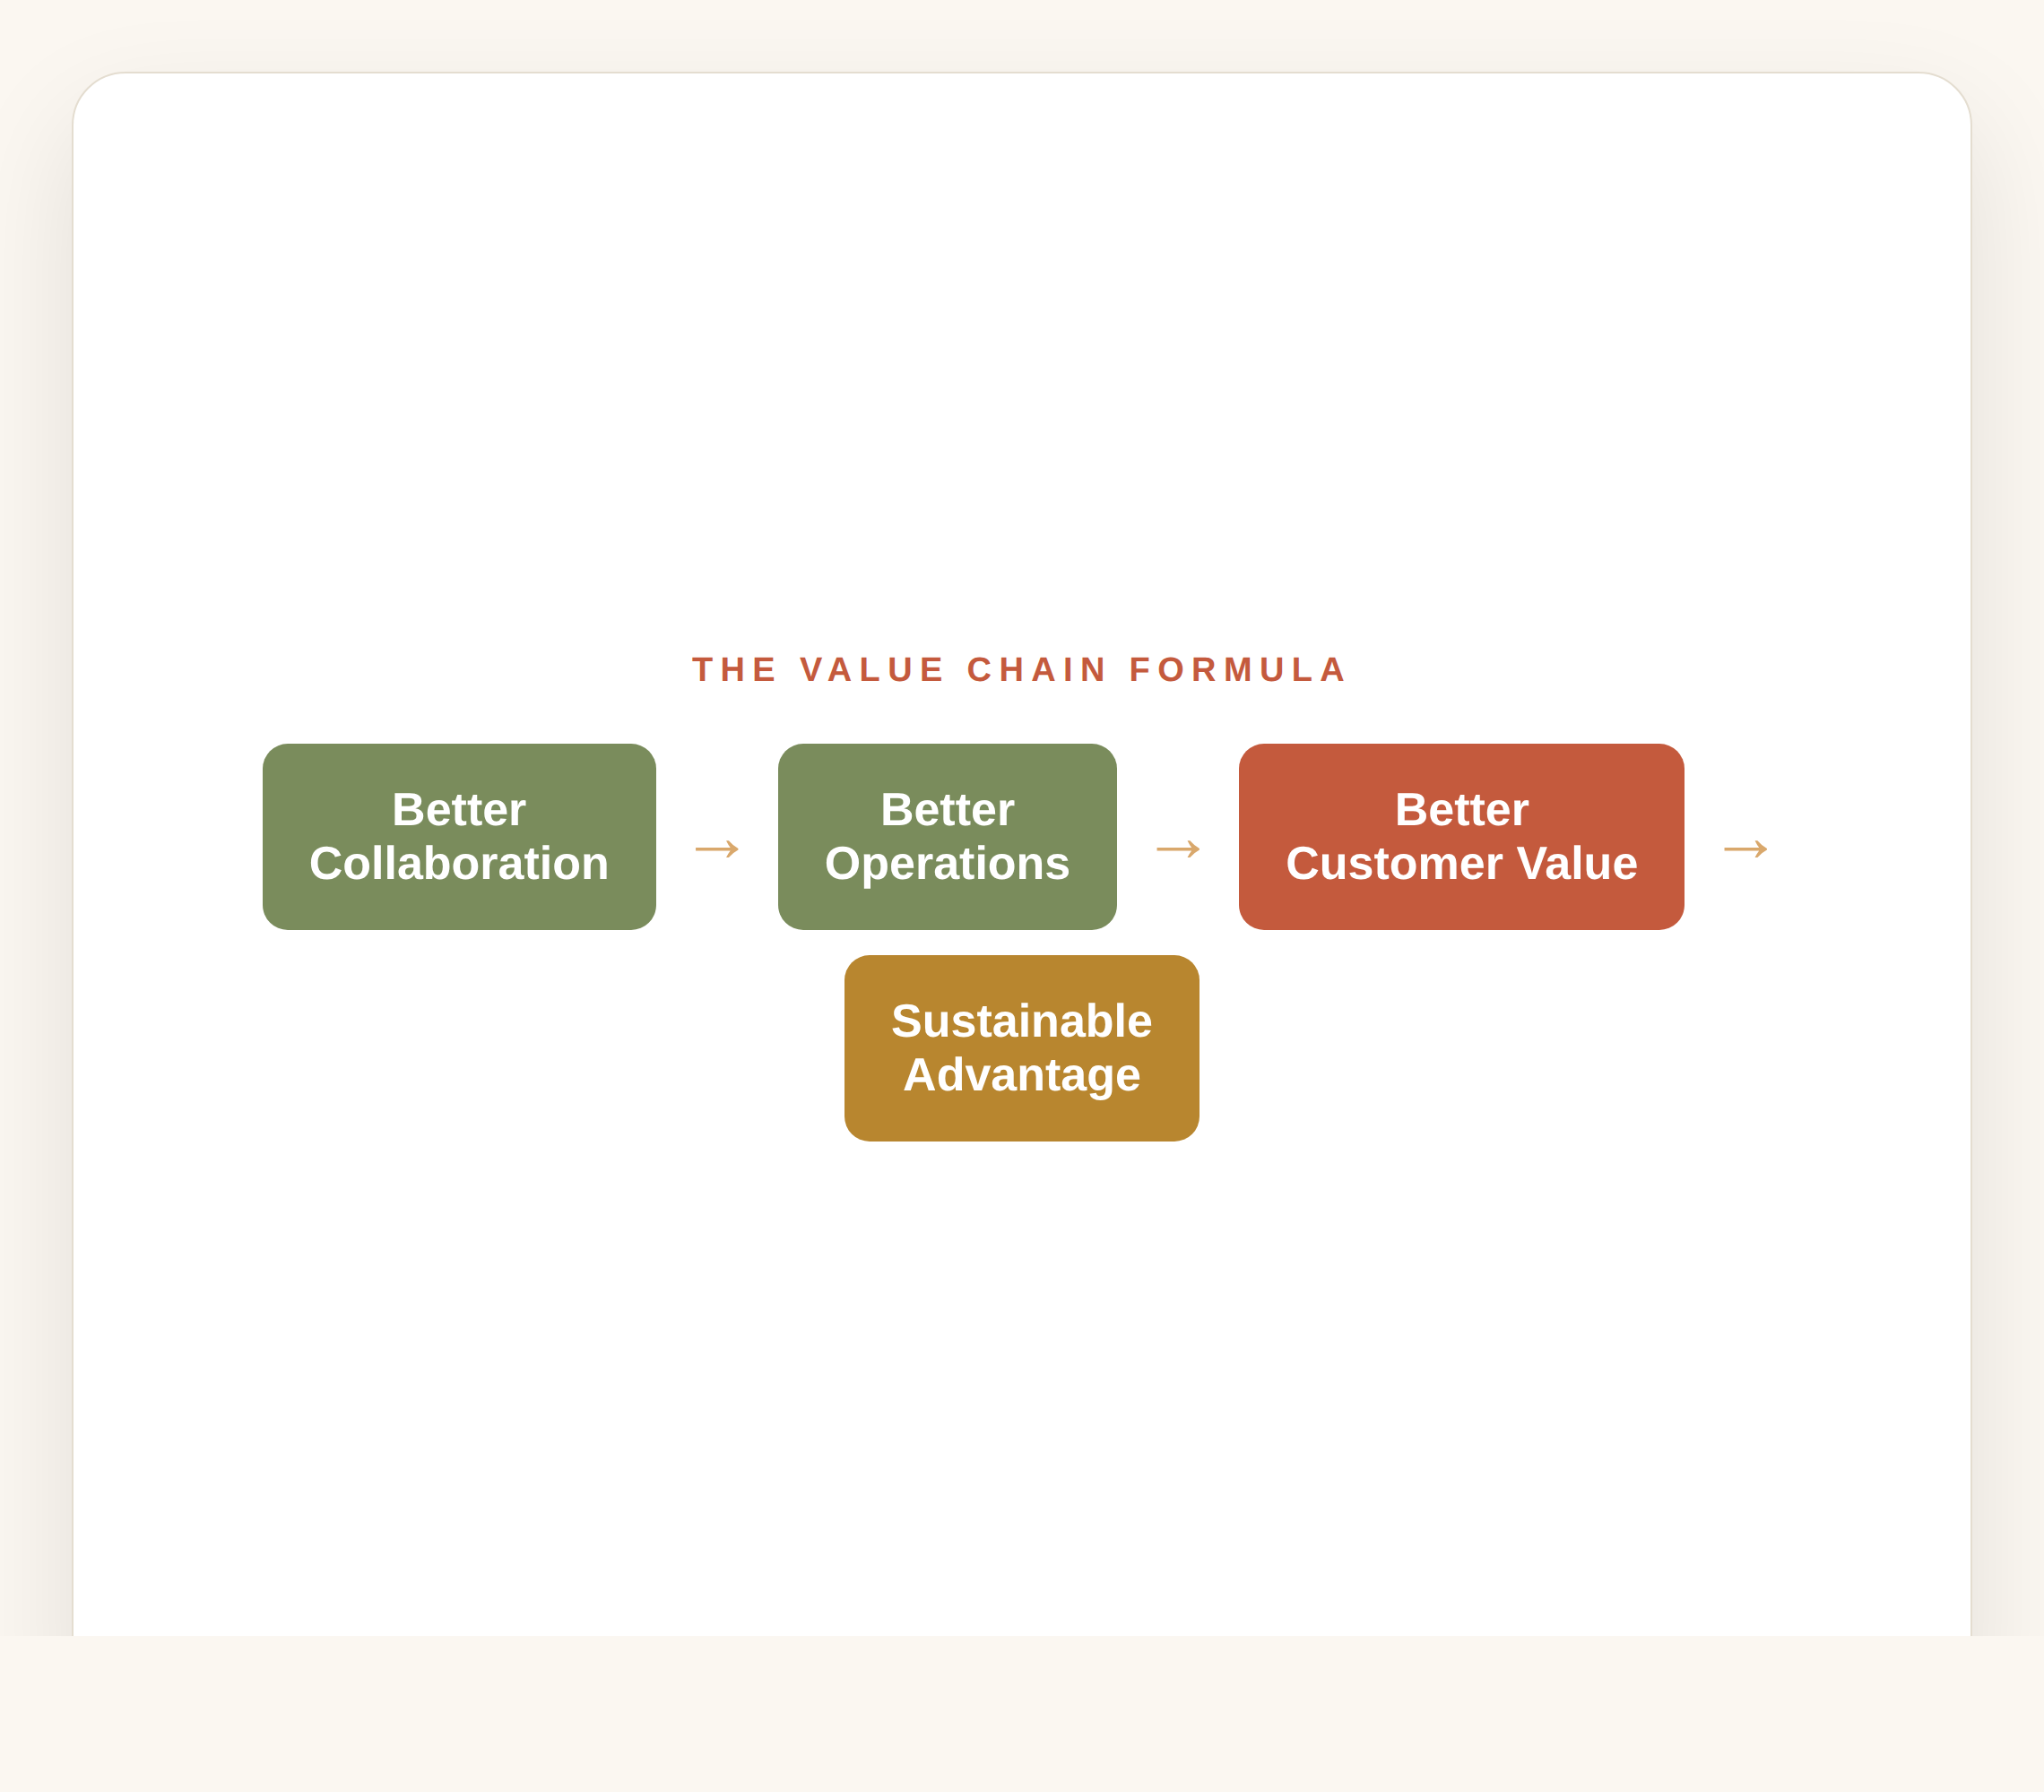
The Value Chain Formula
Better Collaboration → Better Operations → Better Customer Value → Sustainable Competitive Advantage.
Each link strengthens the next, so gains compound along the chain.
The campus is the environment that makes the first link happen.
The Urban Knowledge Campus
06

Slide 8
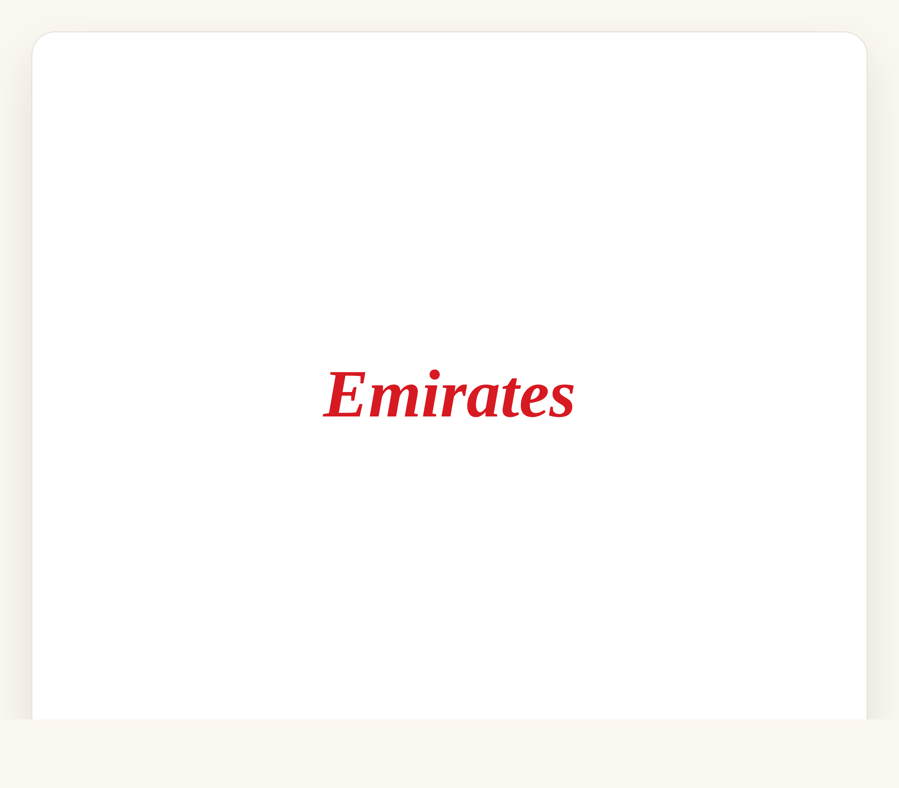
Example — Emirates Airline
Traditional HQ: departments work in isolation.
Campus approach: Flight Operations, Customer Experience, Digital, Engineering, Marketing and Sustainability share integrated workspaces and innovation hubs.
Value created: faster service improvements, better coordination, quicker responses and continuous innovation.
The Urban Knowledge Campus
07

Slide 9

UAE Example — Expo City Dubai
Businesses, researchers, government entities and universities collaborate in one innovation ecosystem.
Benefits: shared knowledge, joint innovation, faster technology adoption, stronger supplier partnerships and improved sustainability.
Instead of isolated companies, Expo City creates an interconnected value chain.
The Urban Knowledge Campus
08

Slide 10
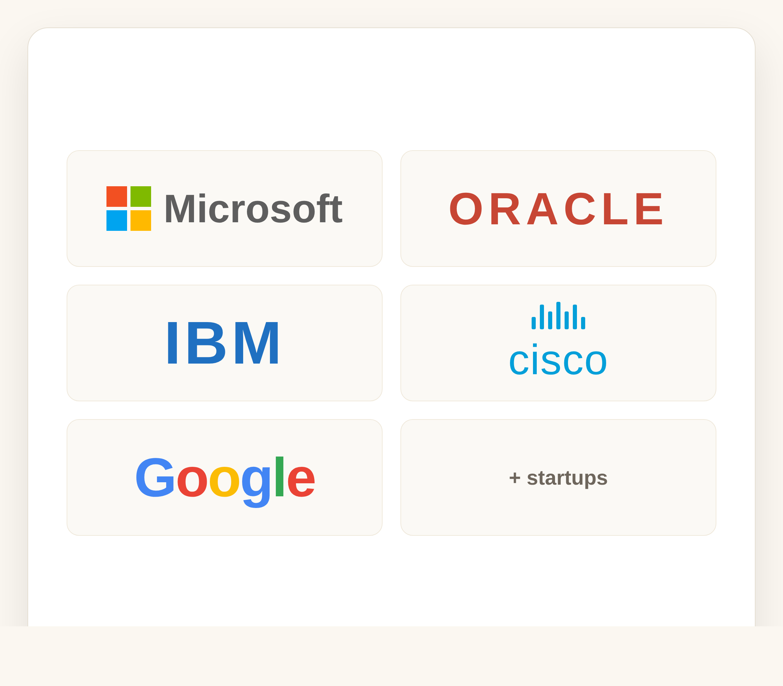
UAE Example — Dubai Internet City
Home to global technology leaders and numerous startups in one hub.
Benefits: knowledge spillovers, talent mobility, shared expertise and innovation partnerships.
It reduces time to develop new products and services — proximity accelerates value creation.
The Urban Knowledge Campus
09

Slide 11

Global Example — Amazon
Campuses bring together software engineers, supply-chain planners, procurement, data scientists and customer-service specialists.
Working closely enables faster decisions, improved forecasting and better inventory management.
More efficient logistics and an enhanced customer experience — every improvement strengthens the value chain.
The Urban Knowledge Campus
10

Slide 12
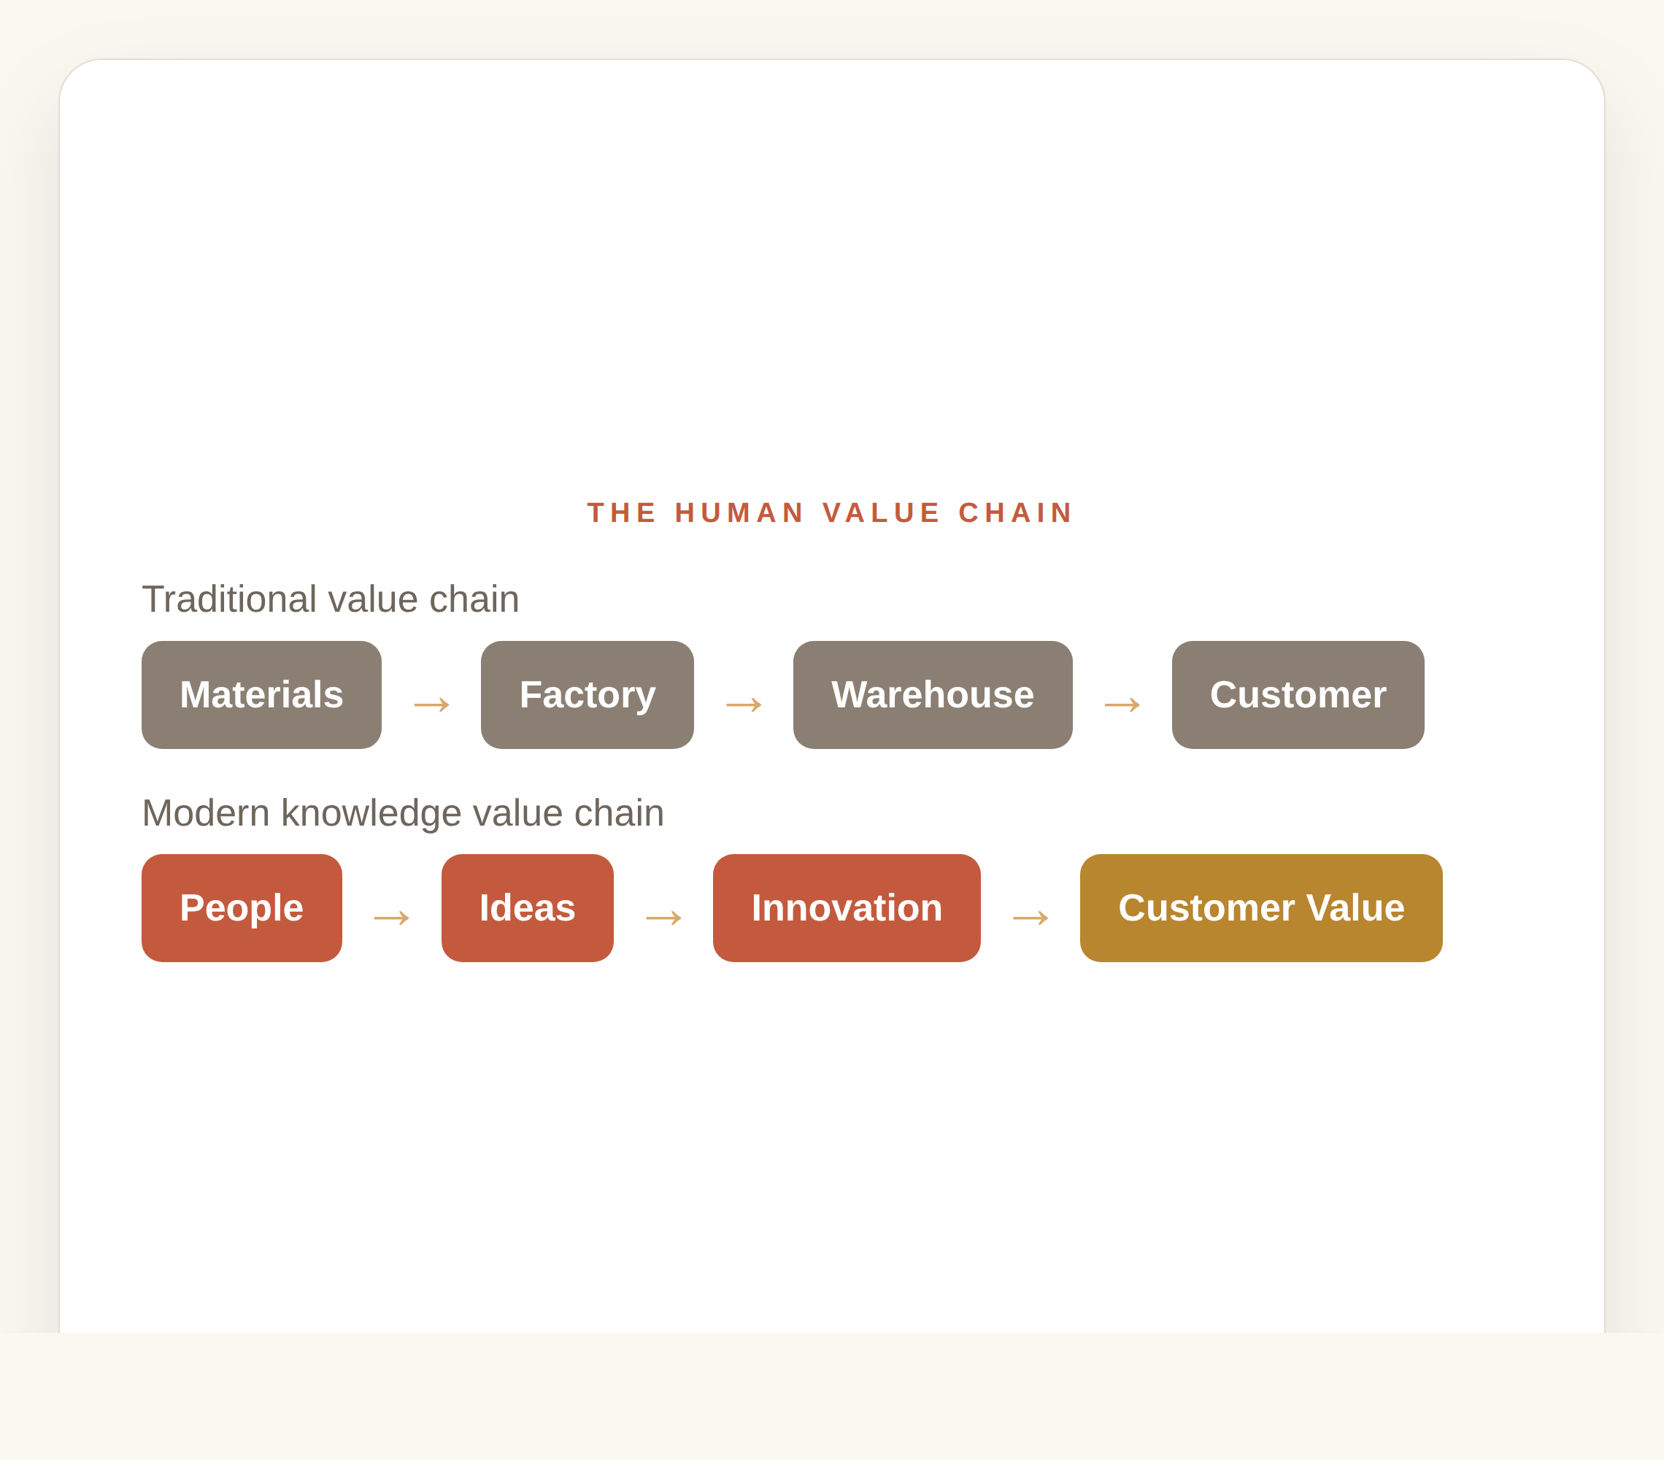
The Human Value Chain
Traditional chain: Materials → Factory → Warehouse → Customer.
Modern knowledge chain: People → Ideas → Innovation → Better Processes → Better Products → Customer Value.
Knowledge has become a critical value-chain input, alongside materials and capital.
The Urban Knowledge Campus
11

Slide 13
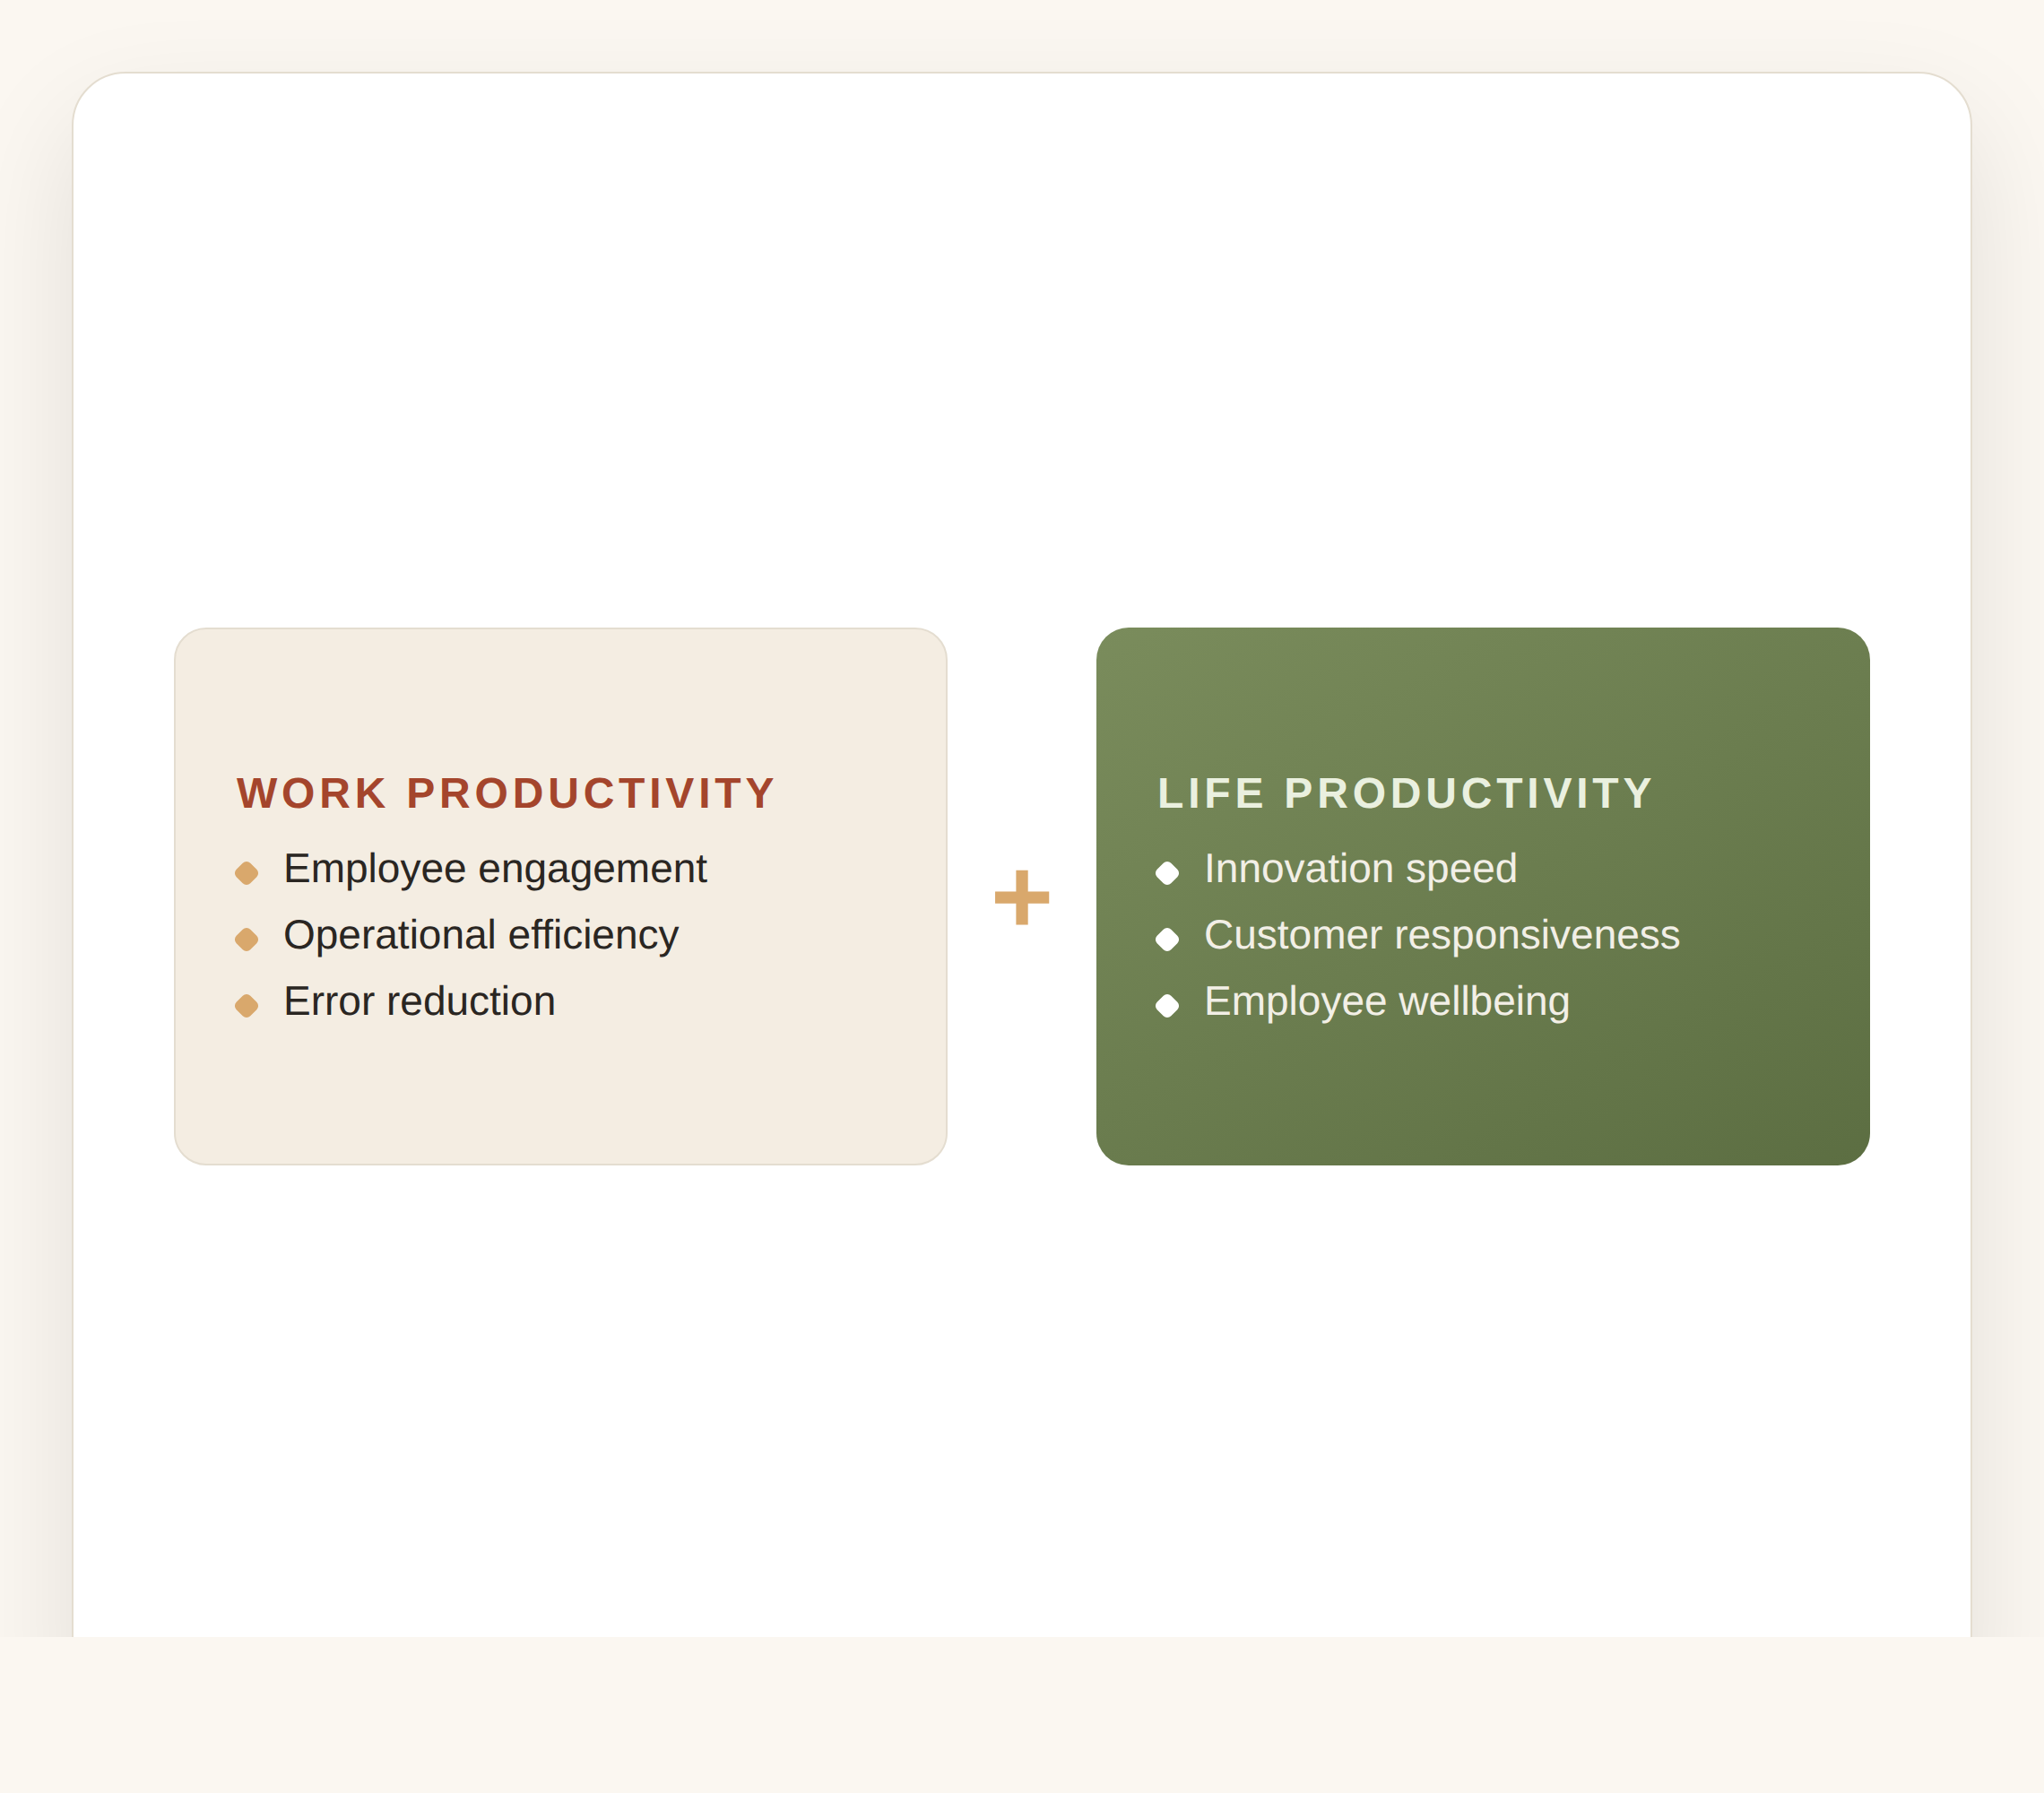
Work vs. Value Chain Productivity
The article distinguishes Work Productivity from Life Productivity.
For value-chain managers both shape engagement, operational efficiency, error reduction, innovation speed and customer responsiveness.
Better employee wellbeing often leads to better value-chain performance.
The Urban Knowledge Campus
12

Slide 14
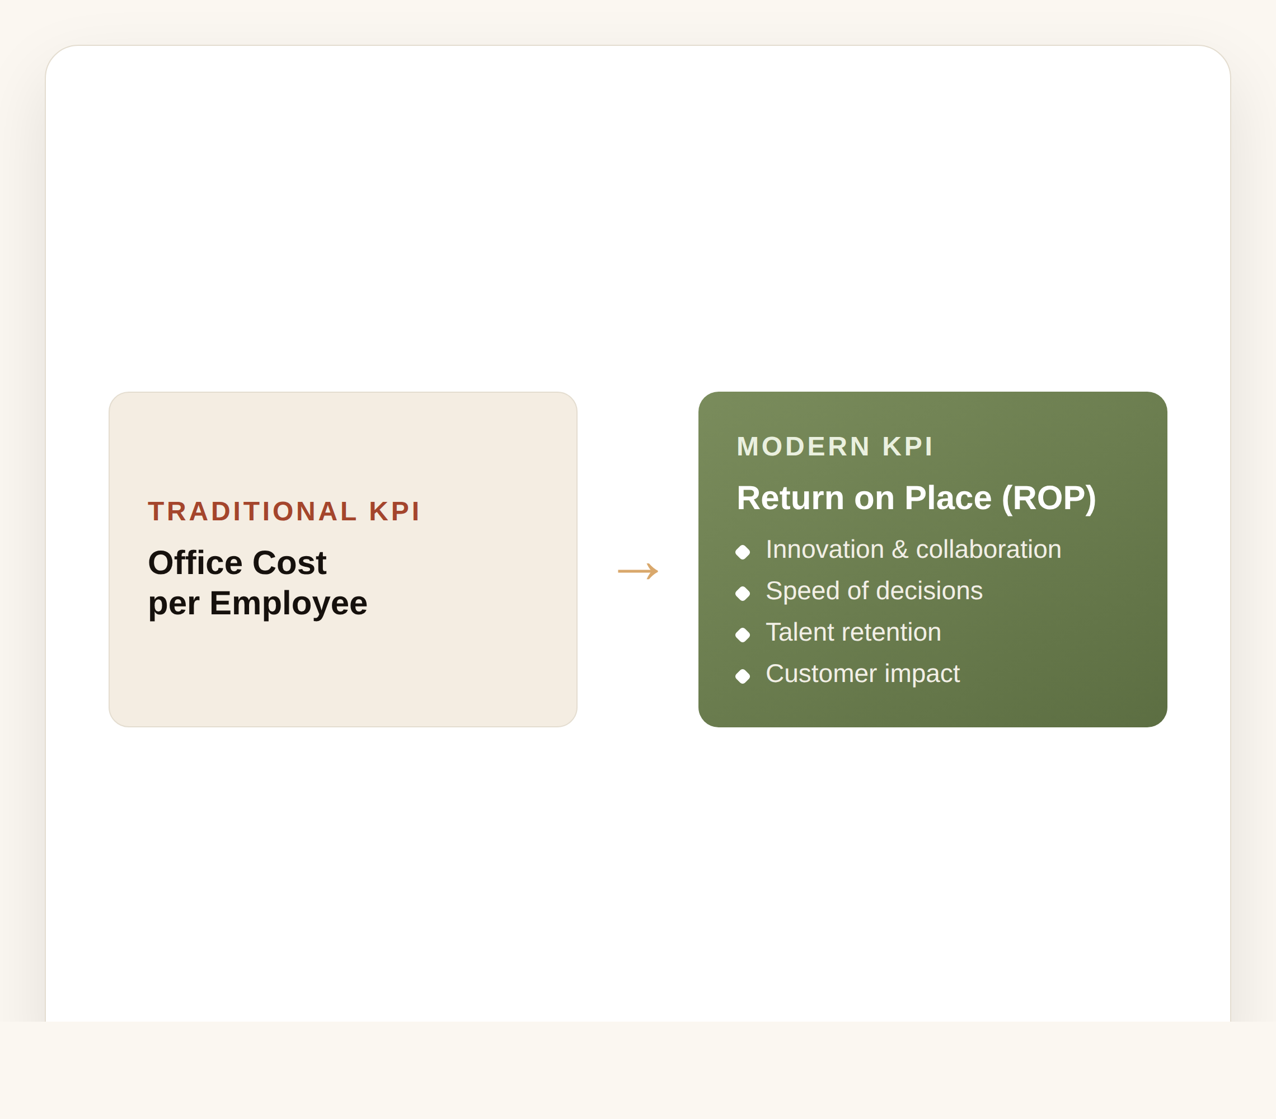
The New KPI — Return on Place (ROP)
Traditional KPI: office cost per employee. Modern KPI: Return on Place.
ROP measures innovation generated, collaboration frequency, speed of decision-making and talent retention.
It also tracks customer impact and operational improvements — the workplace becomes an investment in advantage.
The Urban Knowledge Campus
13

Slide 15
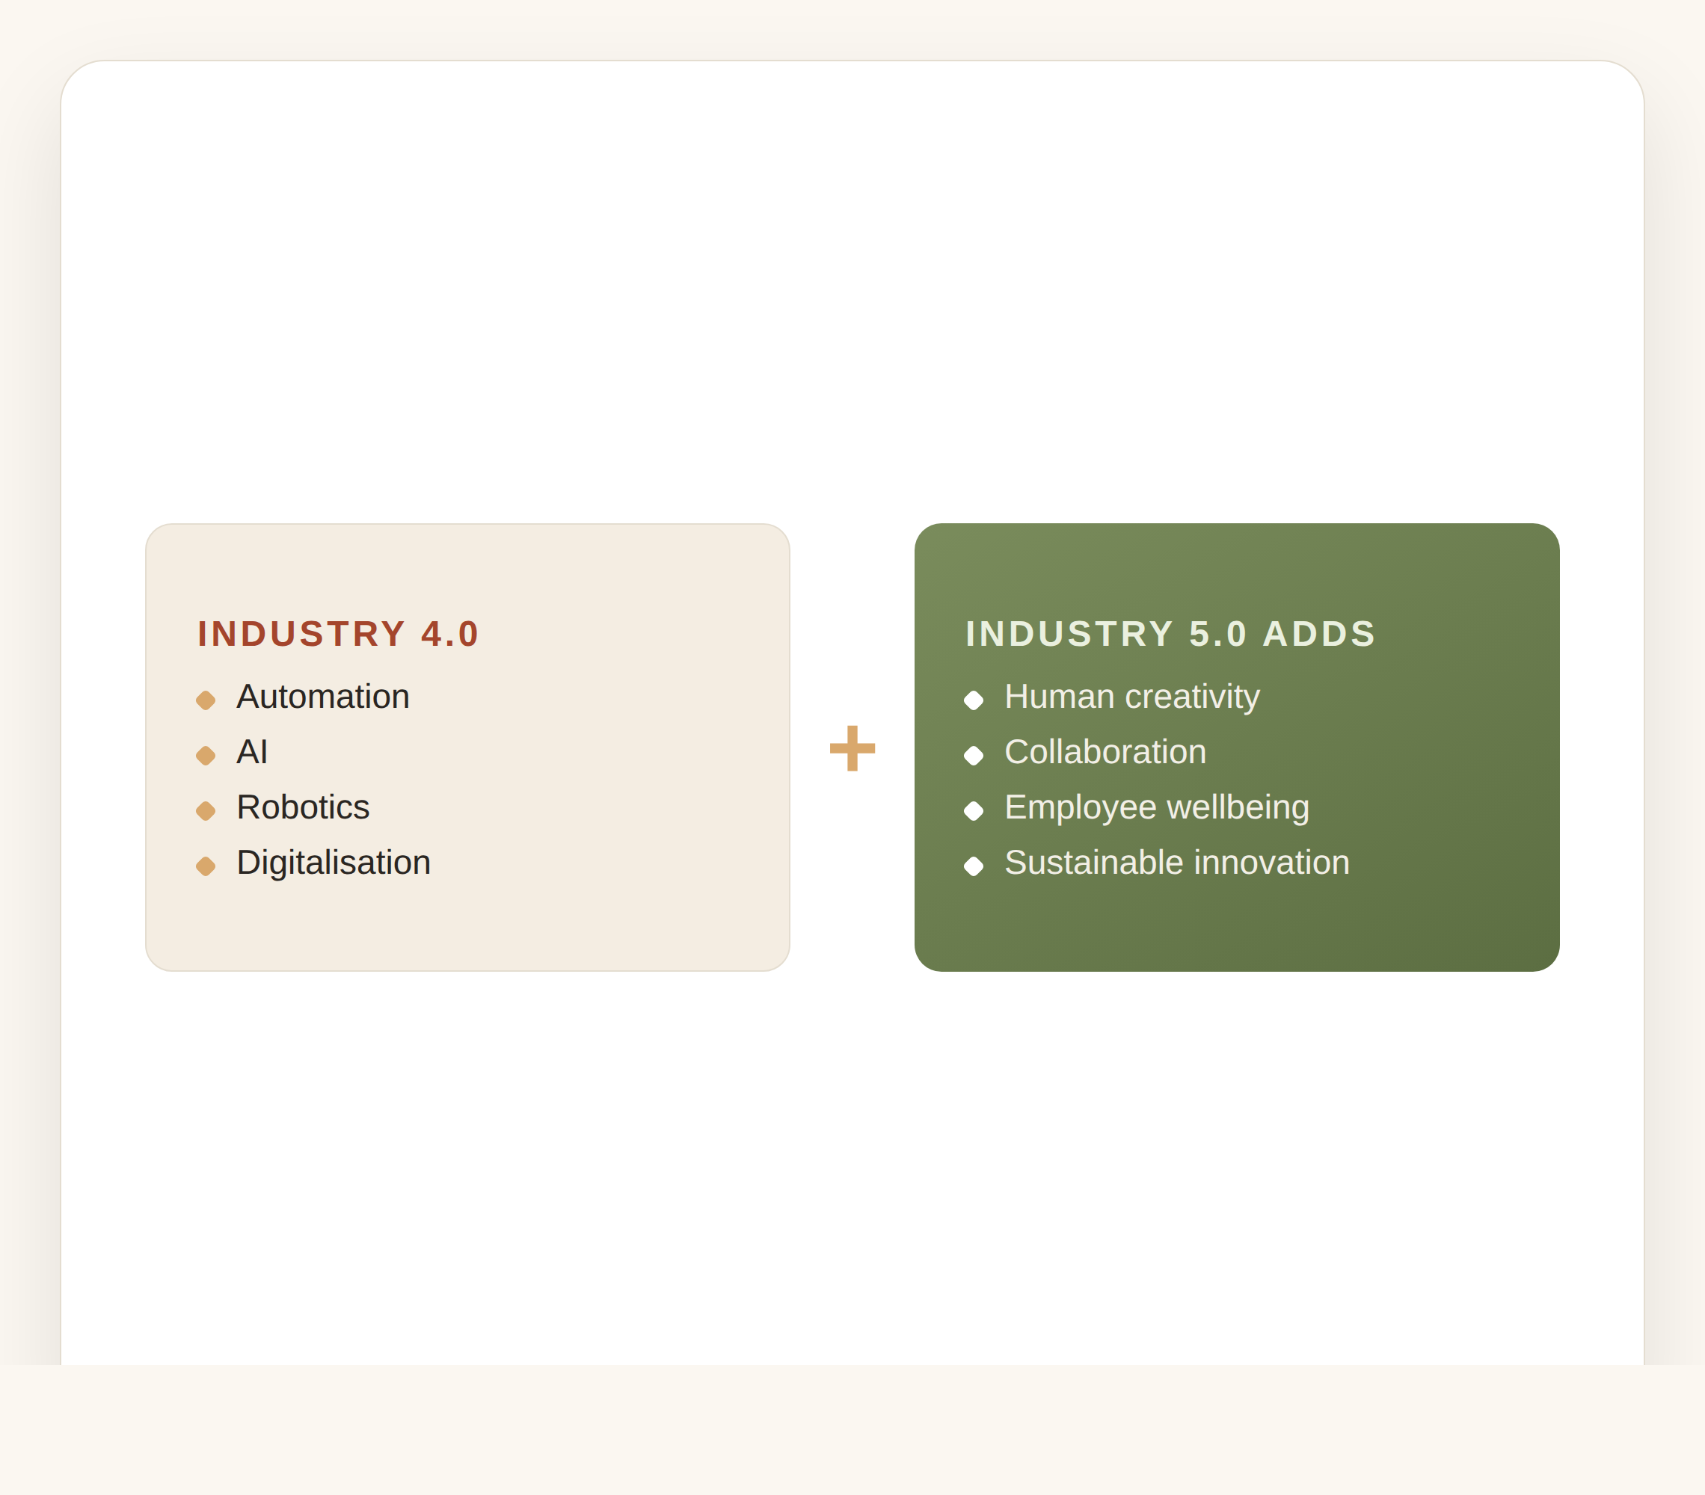
The Industry 5.0 Connection
Industry 4.0 focused on automation, AI, robotics and digitalisation.
Industry 5.0 adds human creativity, collaboration, employee wellbeing and sustainable innovation.
The Urban Knowledge Campus is a practical example of Industry 5.0 in action.
The Urban Knowledge Campus
14

Slide 16

Classroom Activity — DP World (20 min)
Imagine DP World is planning a new Dubai headquarters. As value-chain managers, which departments should be co-located?
How could the campus improve logistics operations and supplier collaboration?
What customer benefits might result — and which KPIs would demonstrate the value?
The Urban Knowledge Campus
15

Slide 17
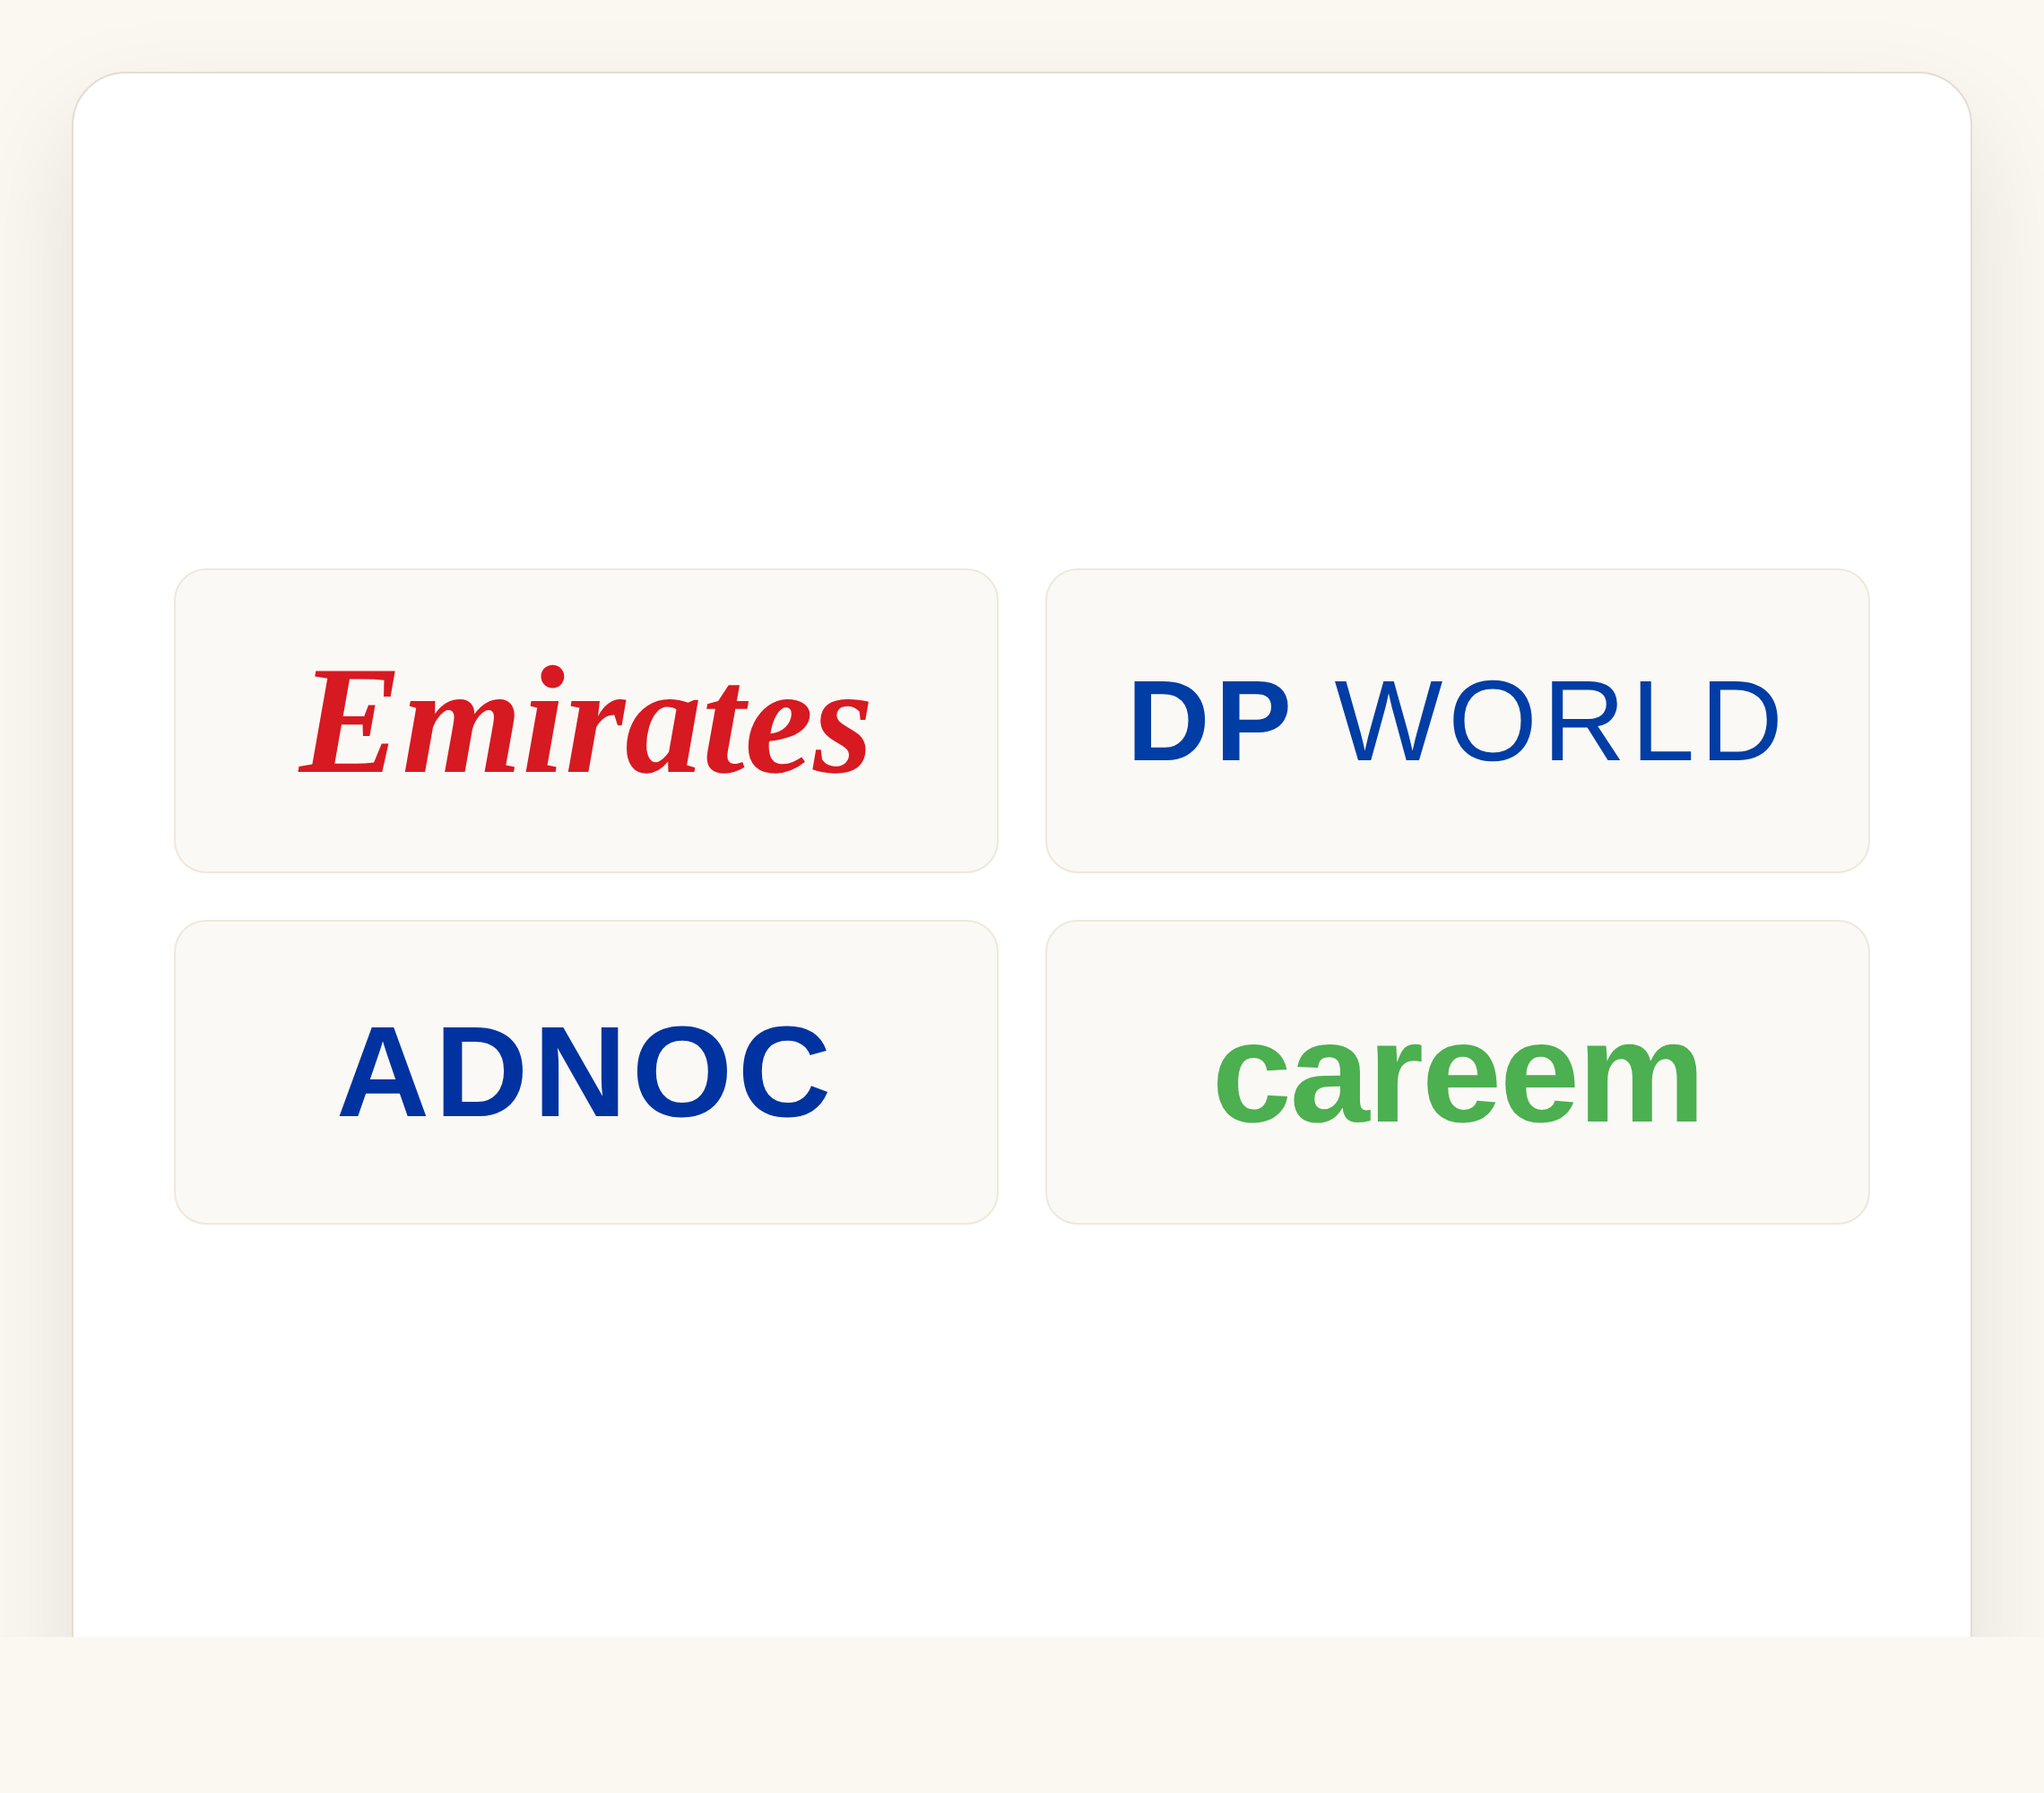
Discussion Questions
Q1 (LO1): How can an Urban Knowledge Campus improve each stage of Porter's value chain?
Q2 (LO2): Which UAE firm benefits most — Emirates, DP World, ADNOC or Careem? Explain your choice.
Q3 (LO3): As a Dubai manufacturing CEO, would you invest AED 2 billion in a knowledge campus? Justify it.
The Urban Knowledge Campus
16

Slide 18
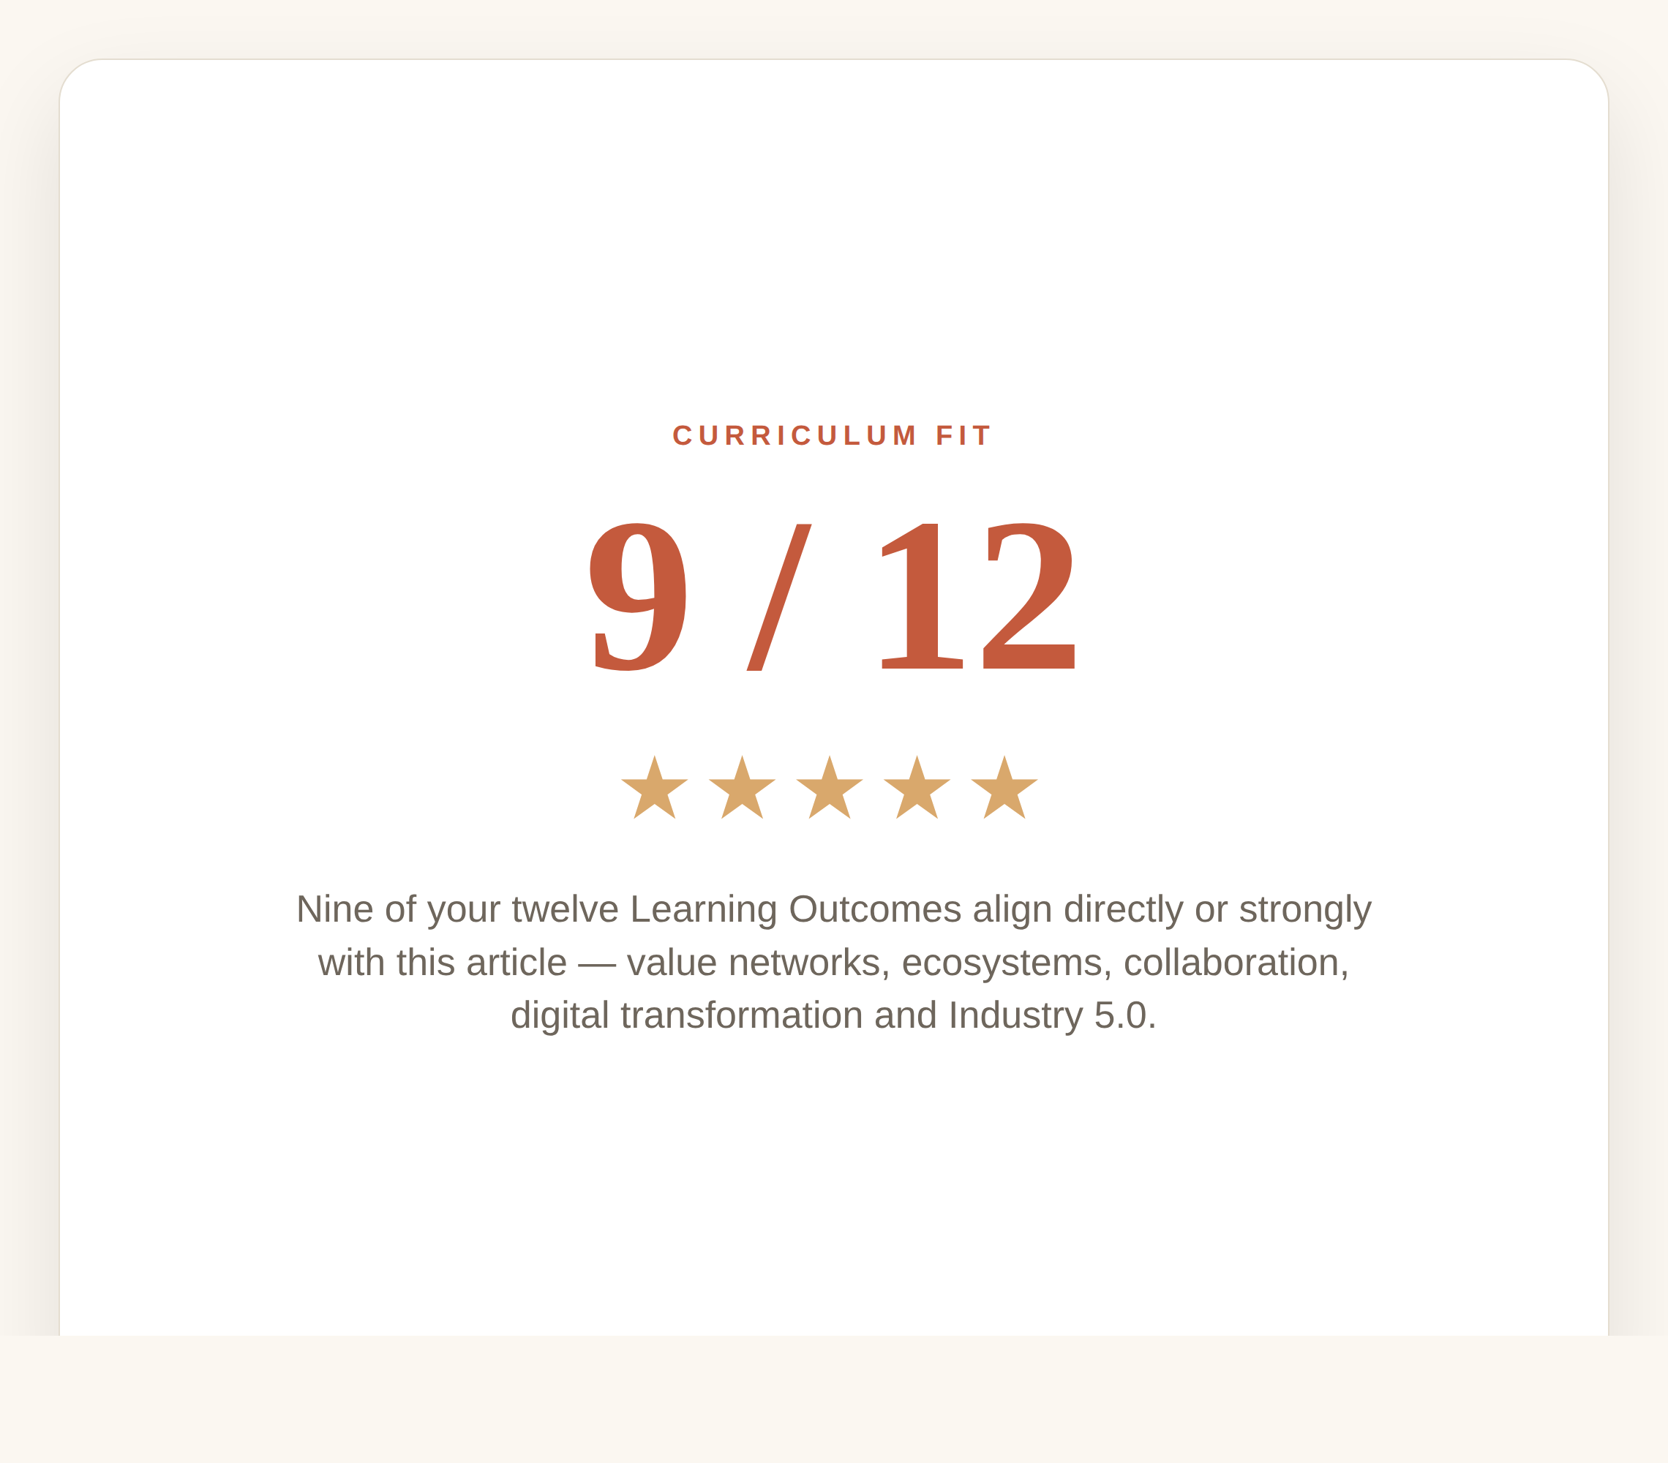
Curriculum Fit
Nine of your twelve LOs align directly or strongly with this article.
Strongest fits: value networks and ecosystems, collaboration across organisations, and emerging global value-chain trends.
It also connects to digital transformation, smart cities and Industry 5.0 thinking.
The Urban Knowledge Campus
17

Slide 19
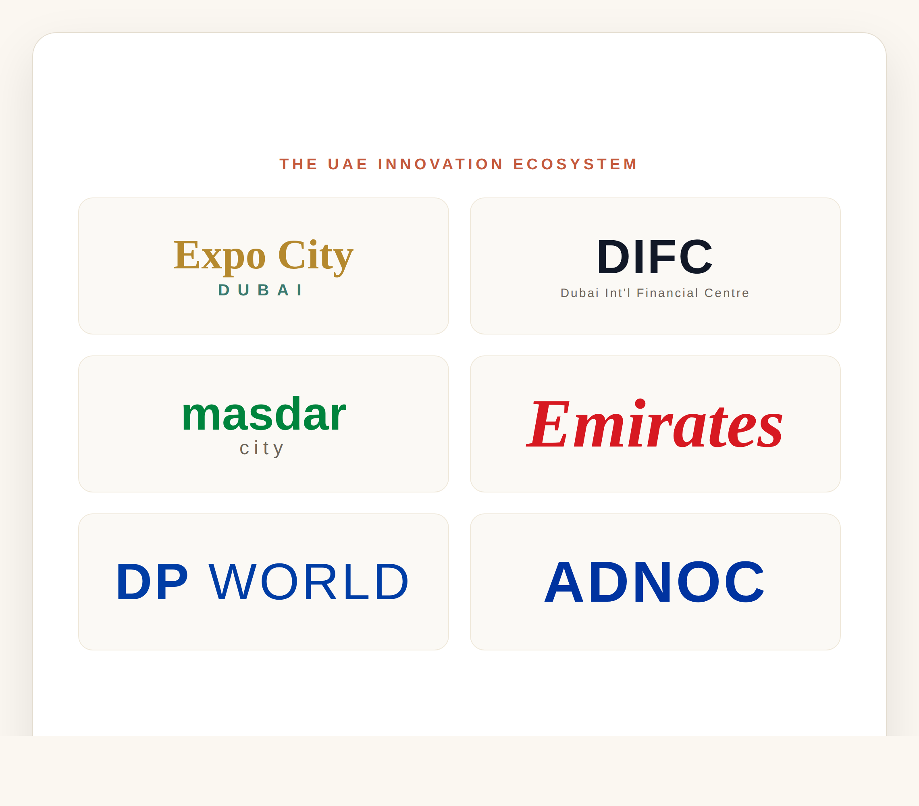
The UAE Innovation Ecosystem
Expo City Dubai, Dubai Internet City, DIFC and Masdar City act as connected knowledge campuses.
Emirates, DP World and ADNOC anchor the country's value chains across aviation, logistics and energy.
Together they turn Porter's value chain, Industry 5.0 and knowledge management into a single UAE framework.
The Urban Knowledge Campus
18

Slide 20
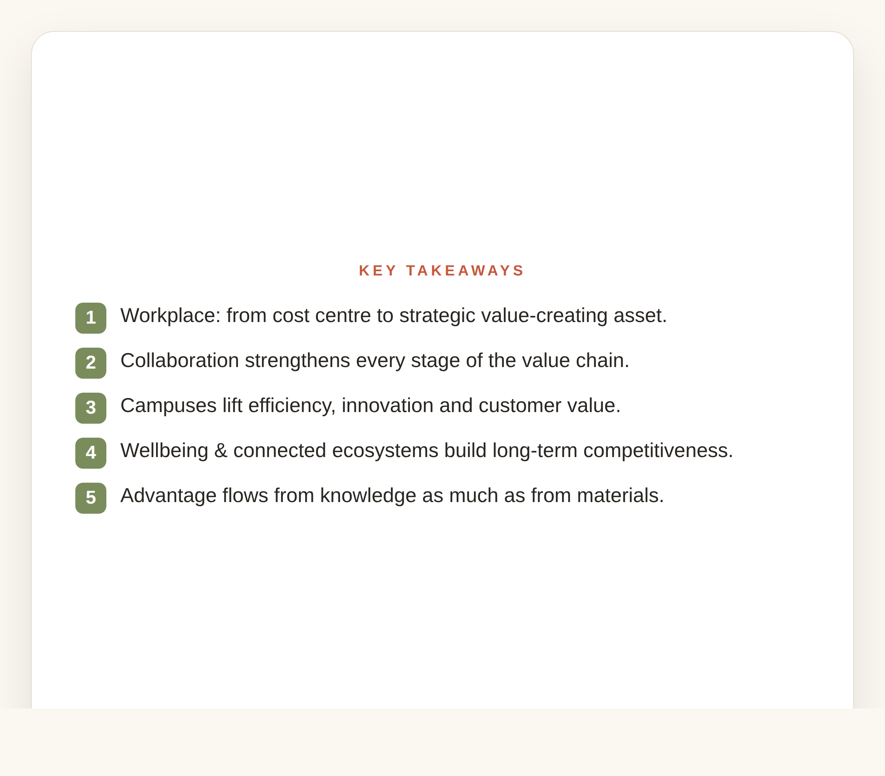
Key Takeaways
The workplace has evolved from a cost centre into a strategic value-creating asset.
Knowledge sharing and collaboration strengthen every stage of the value chain, lifting efficiency, innovation and customer value.
Advantage increasingly comes from the flow of knowledge as much as the flow of materials.
The Urban Knowledge Campus
19

Slide 21
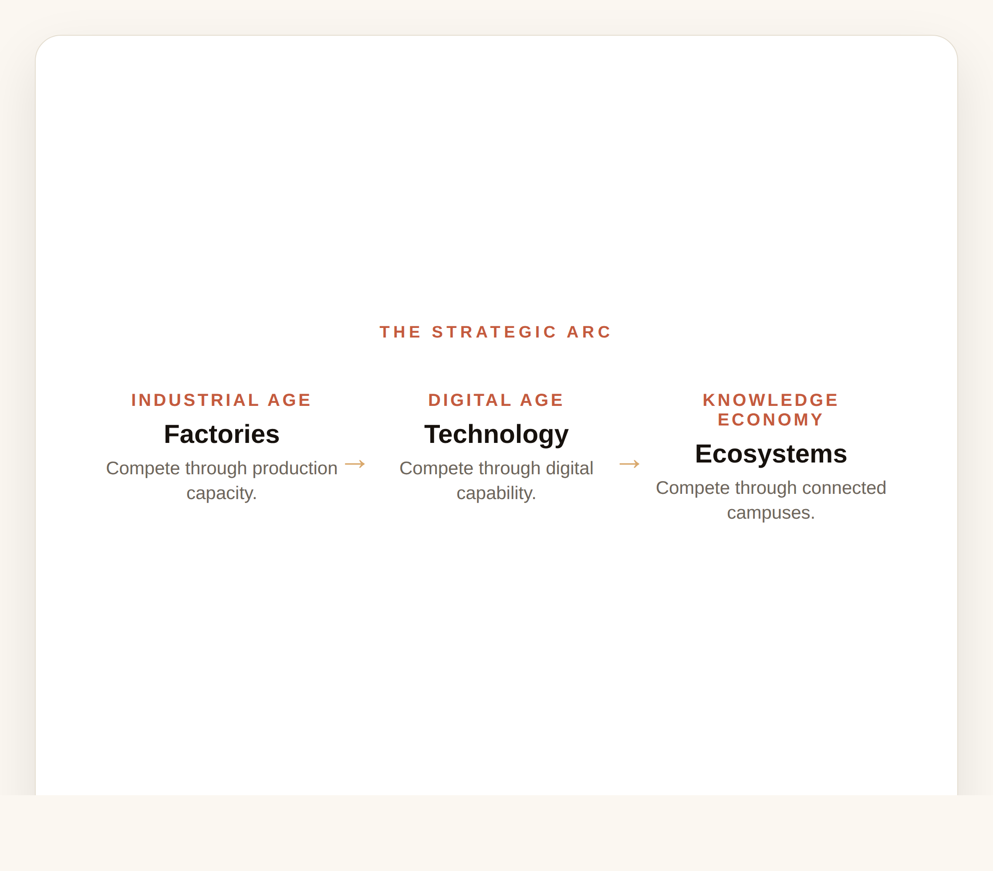
Teaching Insight — The Strategic Arc
Industrial Age: companies competed through factories. Digital Age: through technology.
Knowledge Economy: they compete through ecosystems.
The Urban Knowledge Campus is where people, technology, partners and ideas create superior value together.
The Urban Knowledge Campus
20

Slide 22
Thank you
In the Industrial Age we competed through factories; in the Digital Age through technology; in the Knowledge Economy we compete through ecosystems. The Urban Knowledge Campus brings people, technology, partners and ideas together to create superior value across the entire value chain.
Dr. Aftab Ahmad

