Slide 1
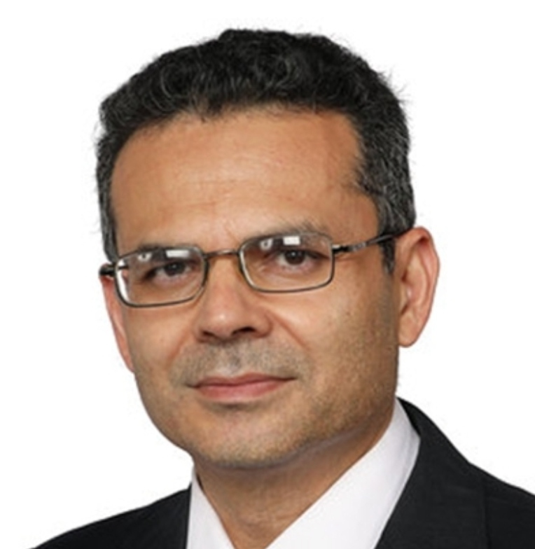
BSC · VALUE CHAIN MANAGEMENT (UAE)
Process Design, Logistics & Global Supply Chain Management
How value chains are analysed, connected and managed across the world — LO3, LO4 & LO5
Dr. Aftab Ahmad
July 2026

Slide 2
One iPhone, five countries
A value chain is every activity that creates value — from raw materials to delivery.
Apple designs in the USA, sources chips from Taiwan, displays from South Korea, assembles in China and India.
Today companies compete as entire supply chains, not as single firms.
🌍
Process Design, Logistics & Global Supply Chain Management
01

Slide 3
What you will be able to do
🎯
LO3 — Apply process analysis and evaluation tools to improve value chain performance.
LO4 — Explain how procurement, production and distribution logistics integrate across the chain.
LO5 — Analyse the evolution of global supply chains and evaluate the trends reshaping them.
Process Design, Logistics & Global Supply Chain Management
02

Slide 4
Tool 1 — Process mapping
A visual map of inputs, activities, decision points and outputs.
Emirates passenger journey: booking → check-in → security → boarding → flight → baggage → feedback.
Dubai International maps passenger flow to cut peak-season waiting; Amazon maps every warehouse step to enable same-day delivery.
🗺️
Process Design, Logistics & Global Supply Chain Management
03

Slide 5
Tool 2 — Value stream mapping
🔍
Every activity is either value-added (assembly, packaging) or waste (waiting, storage).
In smartphone manufacturing, waiting for a machine adds zero value — Lean removes it.
Jebel Ali Free Zone companies use Lean to cut warehouse delays.
Process Design, Logistics & Global Supply Chain Management
04

Slide 6
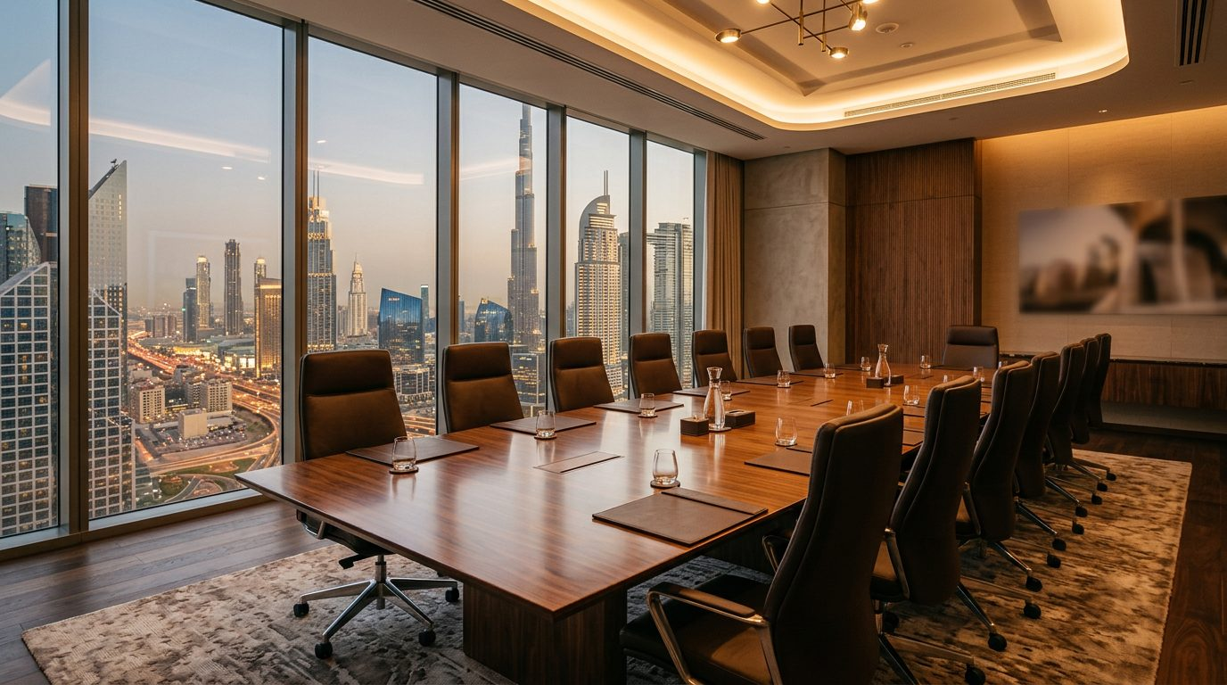
Tools 3 & 4 — Flowcharts and benchmarking
Flowcharts show the operation sequence — supplier → warehouse → factory → distributor → retailer → customer — and expose duplicate work.
Benchmarking compares your delivery time, inventory turnover and satisfaction with industry leaders.
A UAE supermarket benchmarks against Carrefour UAE; Toyota benchmarks quality worldwide.
Process Design, Logistics & Global Supply Chain Management
05

Slide 7
Tool 5 — KPIs: what gets measured improves
📈
Delivery time · inventory turnover · order accuracy · customer satisfaction · cost per unit · defect rate.
Noon tracks delivery success, order completion and customer ratings daily.
KPIs turn 'we feel slow' into 'delivery time rose 12% — fix the sorting step'.
Process Design, Logistics & Global Supply Chain Management
06

Slide 8
Tools 6 & 7 — SWOT and reengineering
SWOT for a UAE logistics firm: strength = location; weakness = high costs; opportunity = e-commerce; threat = global competition.
Business Process Reengineering redesigns workflows entirely instead of patching them.
Banks moved from branches to digital banking; UAE Pass digitized government services and cut the paperwork.
♻️
Process Design, Logistics & Global Supply Chain Management
07

Slide 9

Class activity — map Talabat
Draw Talabat's chain from restaurant partner to your door.
Mark the value-added activities, the waste, and the bottlenecks.
Propose the improvements you would make first — and defend them.
Process Design, Logistics & Global Supply Chain Management
08

Slide 10
Logistics — the six rights
Logistics plans, implements and controls the movement and storage of goods, services and information.
It connects every stage: supplier → procurement → production → distribution → retailer → customer.
Without logistics, the entire value chain fails.
🚚
Process Design, Logistics & Global Supply Chain Management
09

Slide 11
Procurement logistics
📦
Supplier selection, purchasing, transport, receiving, warehousing, inventory control.
Emirates Flight Catering imports ingredients from many countries so meals are never missing.
Tesla sources batteries, lithium and electronics globally — facing supplier delays, currency swings and political risk.
Process Design, Logistics & Global Supply Chain Management
10

Slide 12
Production logistics
Material handling, machine scheduling, production planning, quality control.
A water plant flows: raw material → bottle production → filling → packaging → storage.
Almarai's UAE operations schedule production to meet supermarket demand with minimum waste.
🏭
Process Design, Logistics & Global Supply Chain Management
11

Slide 13
Distribution — and the road back
🔄
Distribution: warehousing, transport, order processing, retail delivery — Noon Express runs warehouse → sorting → vehicle → customer.
Amazon Prime adds automated warehouses, AI routing and drone trials.
Reverse logistics handles returns, repairs and recycling — Apple collects old iPhones for materials recovery.
Process Design, Logistics & Global Supply Chain Management
12

Slide 14
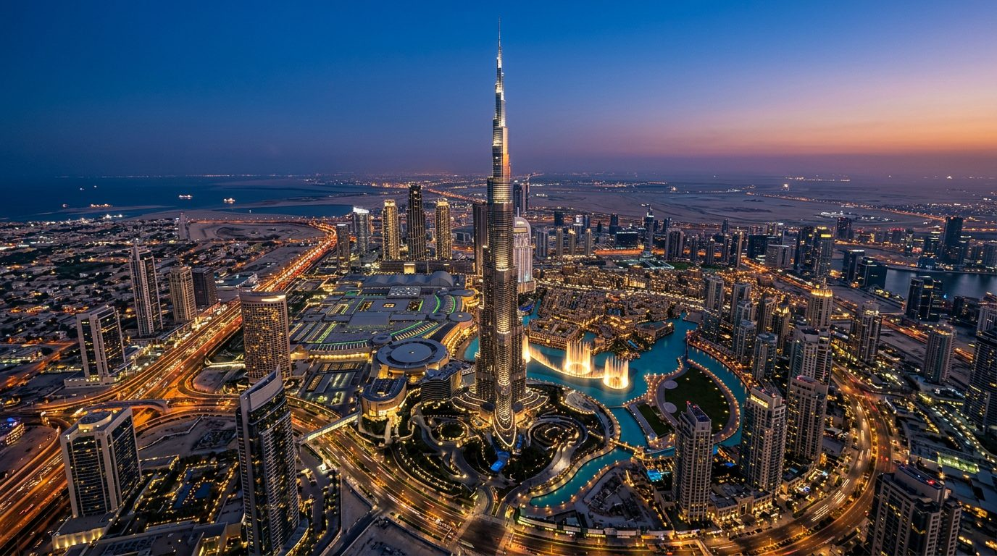
Why is Dubai a world logistics hub?
DP World integrates ports, warehouses, shipping, customs, road transport and digital tracking into one ecosystem.
Logistics is cross-functional — it links marketing, finance, procurement, operations, sales and service.
Coordination creates economies of scale, scope and value (Emirates Flight Catering, Majid Al Futtaim, Amazon Prime).
Process Design, Logistics & Global Supply Chain Management
13

Slide 15
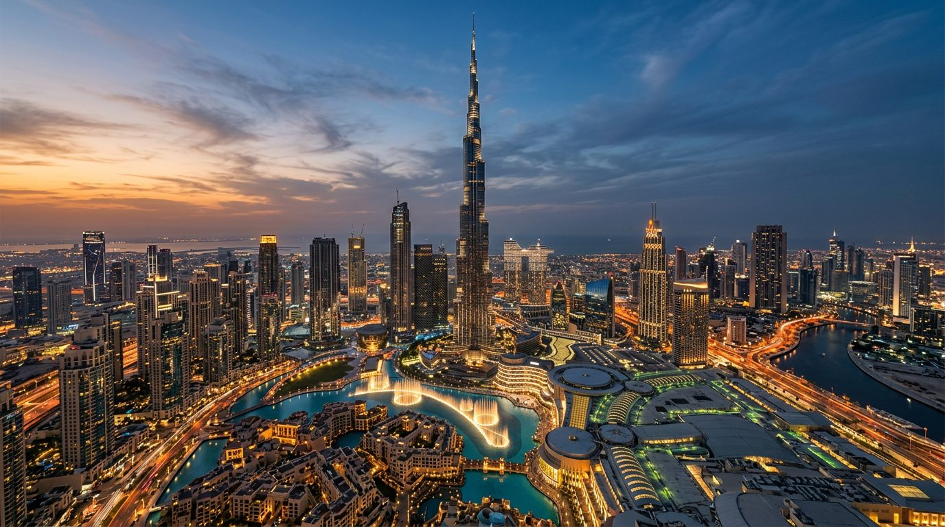
Global supply chain management
Raw materials → components → factory → warehouse → distributor → retailer → customer, spread across the globe.
Firms globalize for lower costs, skilled labour, new markets, tax advantages and resources.
Majid Al Futtaim imports, stores in UAE distribution centres, and supplies Carrefour across the Middle East.
Process Design, Logistics & Global Supply Chain Management
14

Slide 16
When one link breaks
Global risks: political instability, trade wars, disasters, pandemics, cyber attacks, climate, exchange rates.
Factory shutdowns in China during COVID-19 disrupted manufacturing worldwide.
The answer is resilience: multiple suppliers, safety stock, nearshoring and regional warehouses.
⚠️
Process Design, Logistics & Global Supply Chain Management
15

Slide 17
Five trends shaping tomorrow's chains
🚀
Digital chains (AI, IoT, blockchain — DP World tracks containers with AI) and automation (Amazon Robotics).
Sustainability: green logistics, EVs and Masdar-backed Net Zero initiatives in the UAE.
E-commerce growth drives last-mile logistics for Noon, Amazon UAE, Talabat and Careem — while DP World operates in 70+ countries.
Process Design, Logistics & Global Supply Chain Management
16

Slide 18
Thank you
For the tutorial: draw the value chain of Noon UAE, mark where value is created, and suggest three strategies a UAE retailer could use to build supply chain resilience after a global disruption.
Dr. Aftab Ahmad

